Slide 1
PATENT LAW TRENDS, examples & statistics
Chris regan 2/27/19

Slide 2
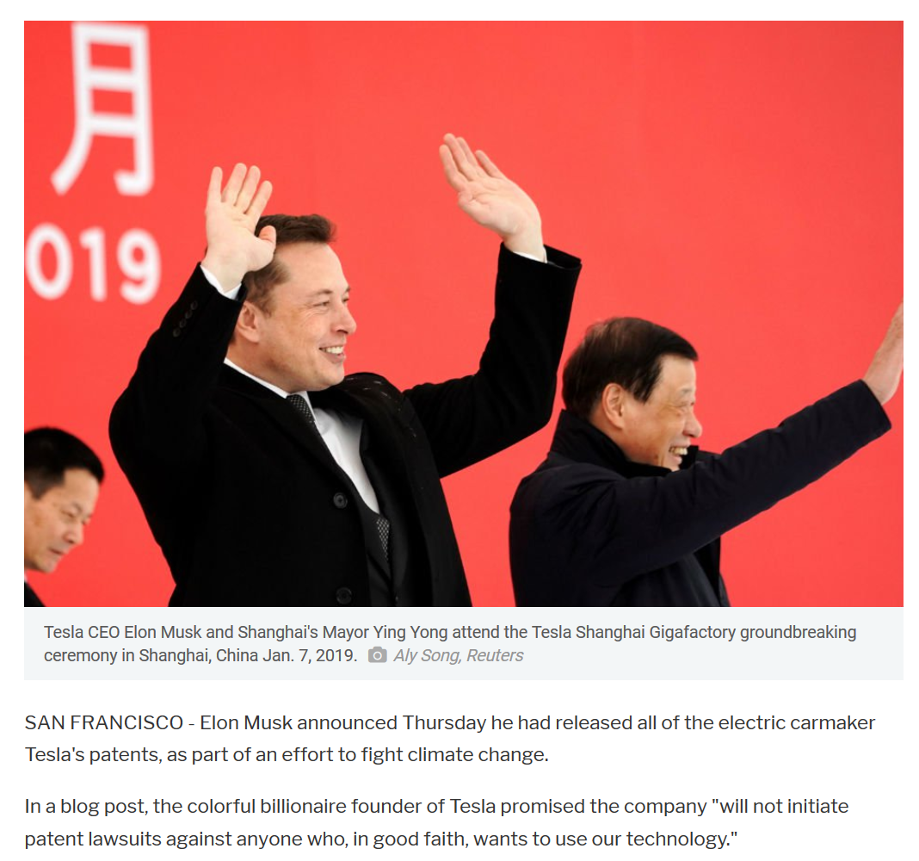
Us – Weak or strong patent system?
Actors: PTO, Congress, Courts, large users…, patent bar
  PTO – active in 101 area
  Congress – low priority
  Courts – struggling with 101, litigation drop off
  Large users still largely anti-patent
  Midsize users hard to get investment money
  Patent bar – commodity prosecution, litigation by investor funding

Slide 3
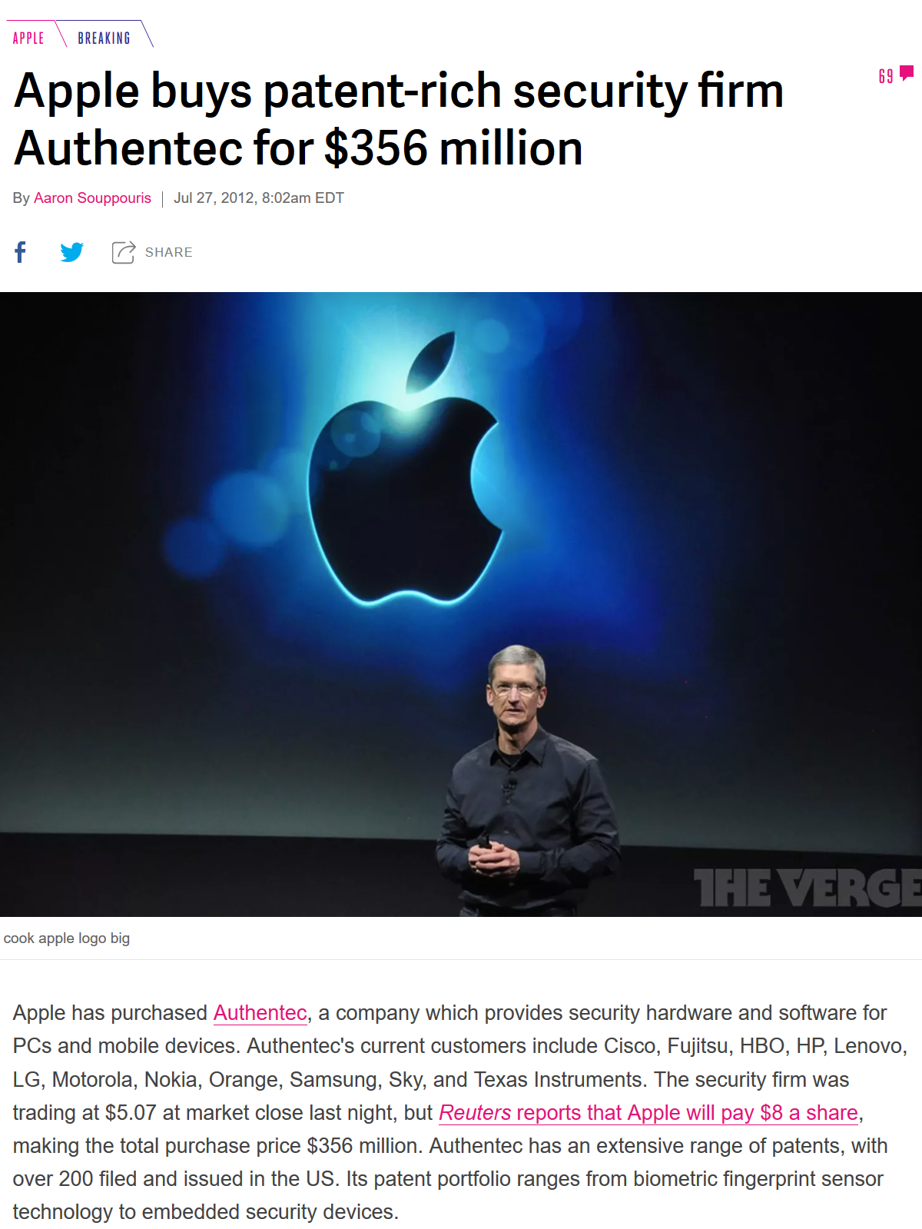
Us – Weak or strong patent system?
Goal: Encourage innovation, by giving predictable return on investment (Old Days)

Slide 4
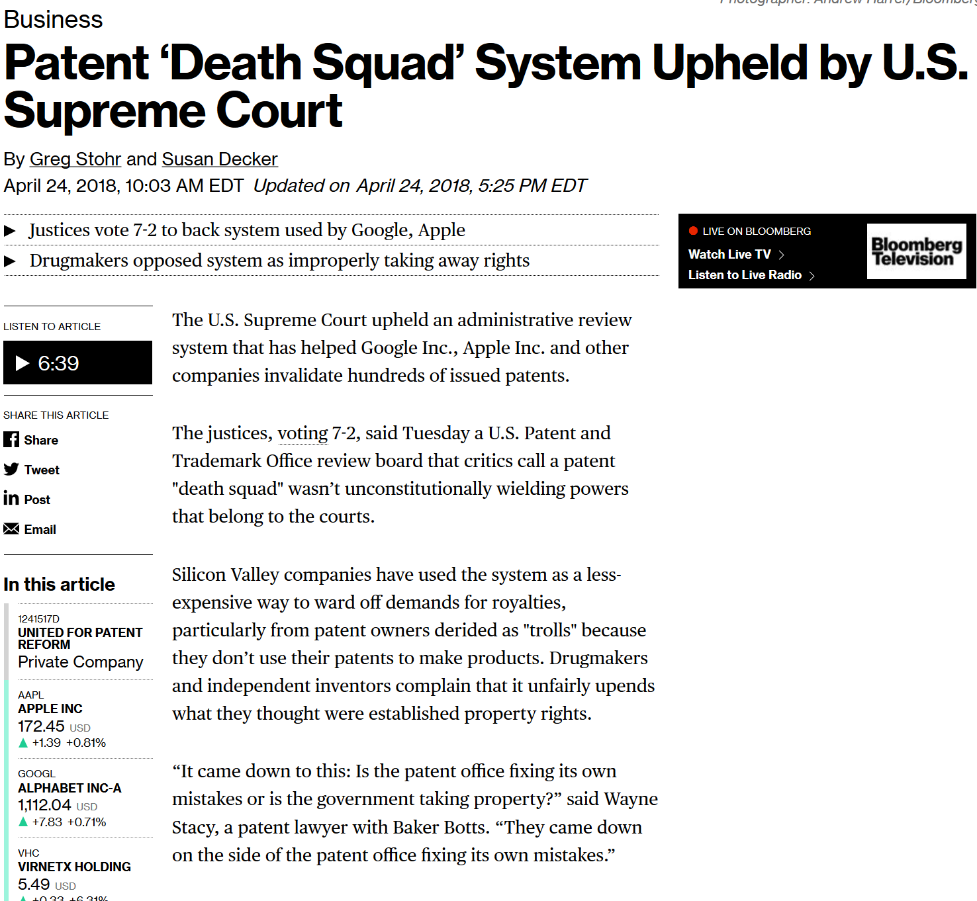
Us – Weak or strong patent system?
Goal: Encourage innovation, by giving predictable return on investment (New Days, same SCOTUS)

Slide 5
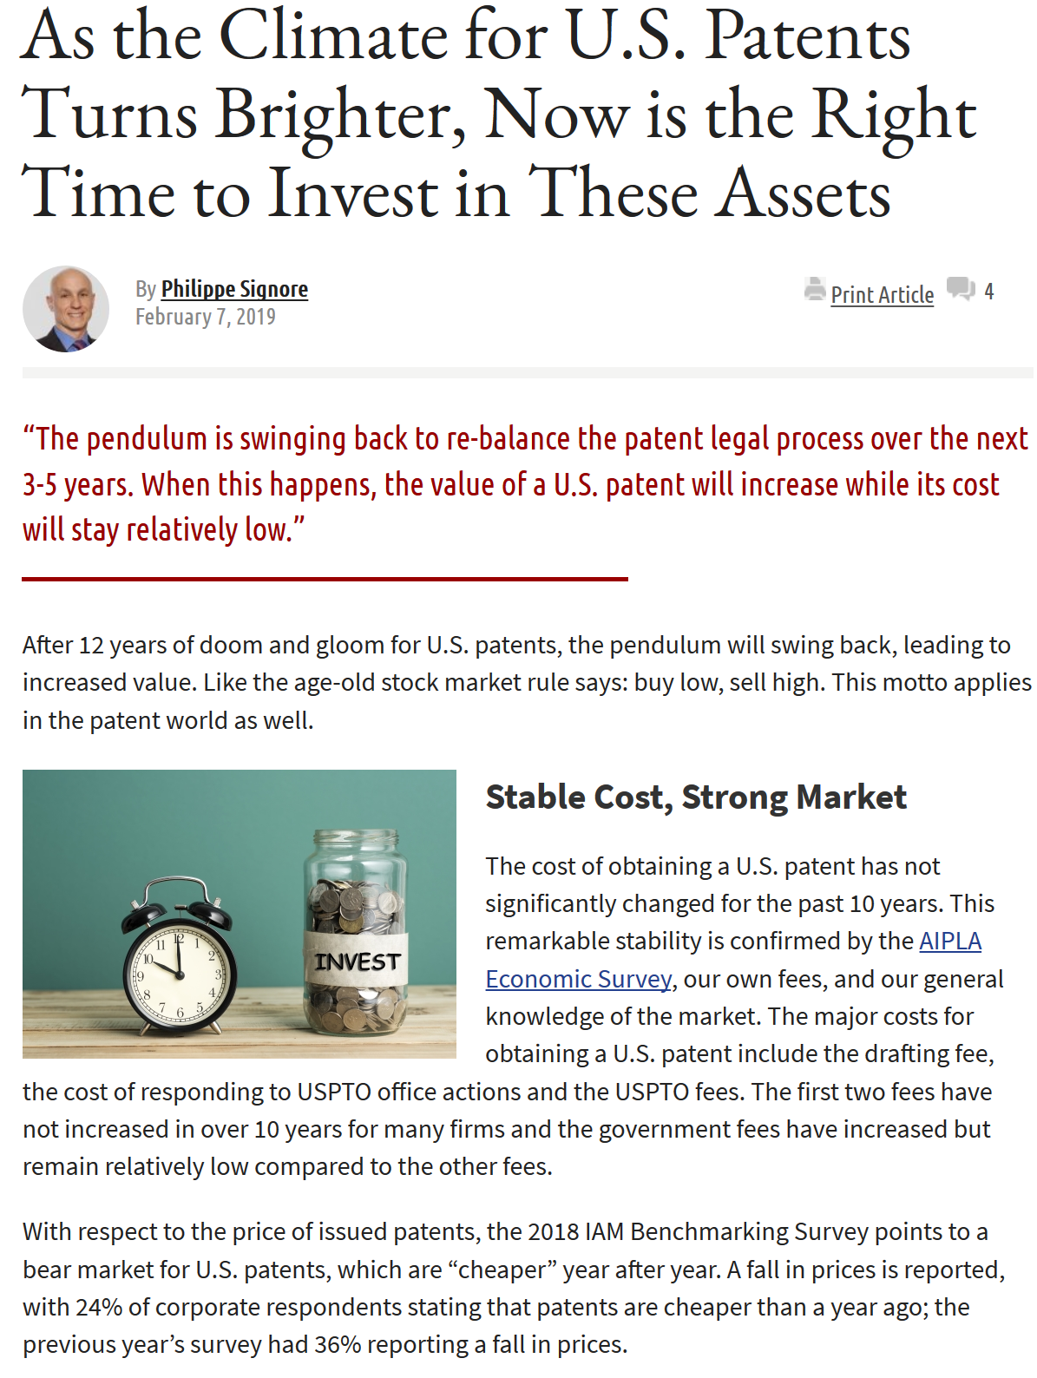
Us – Weak or strong patent system?
Goal: Encourage innovation, by giving predictable return on investment
Legal fees for patent haven’t increased in 10 years
Is the pendulum swinging back?

Slide 6
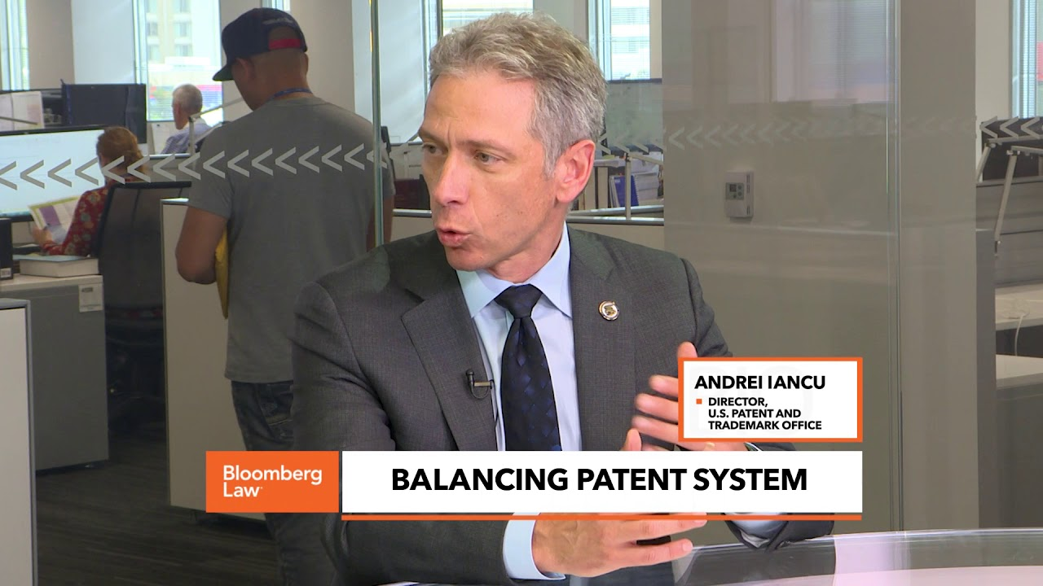
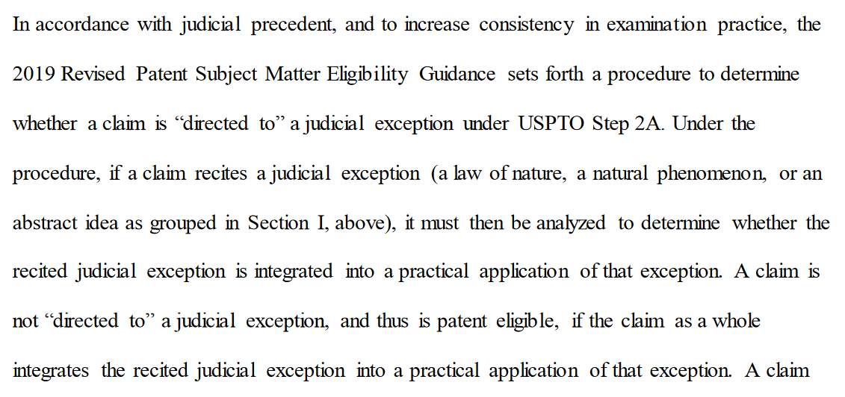
Us – Weak or strong patent system?
PTO Director Pro-Patent, New Subject Matter Guidance

Slide 7
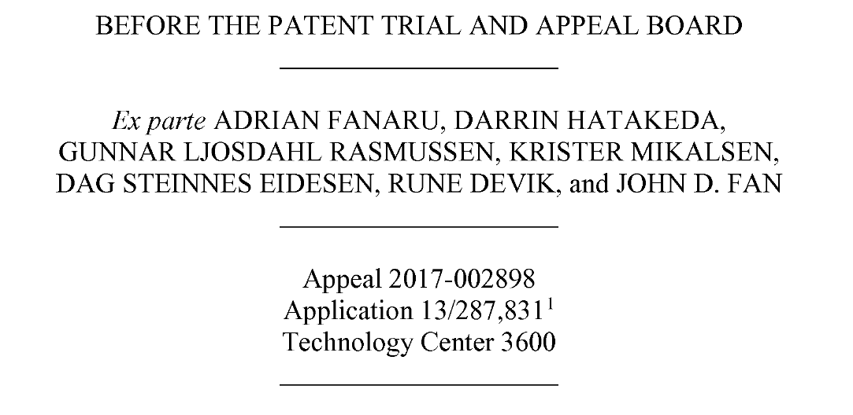
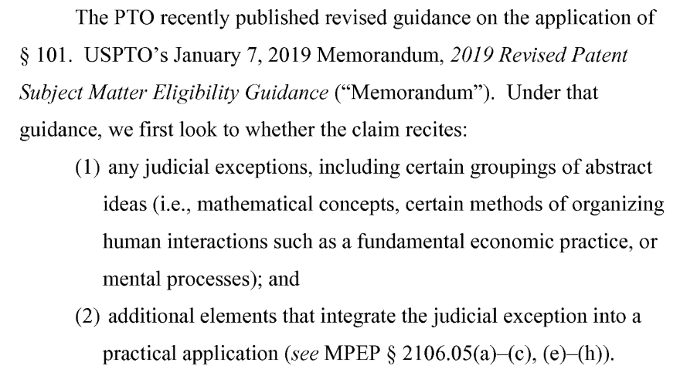
Us – Weak or strong patent system?
PTAB is using new Guidance, 101 less likely, expect 103 rejections

Slide 8
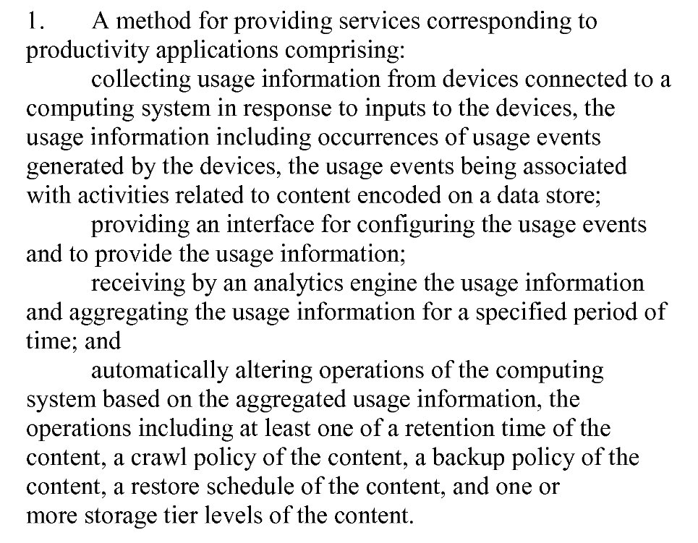
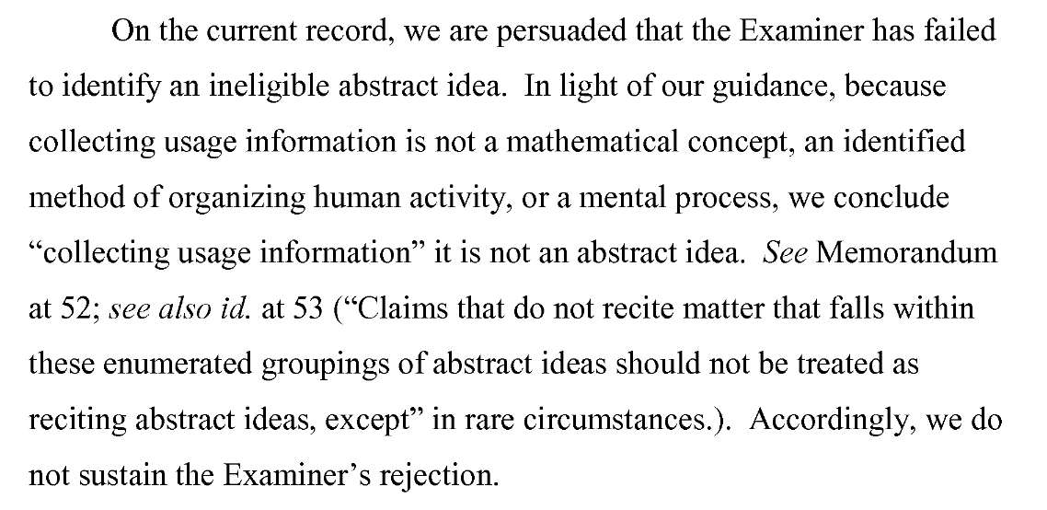
Us – Weak or strong patent system?

Slide 9
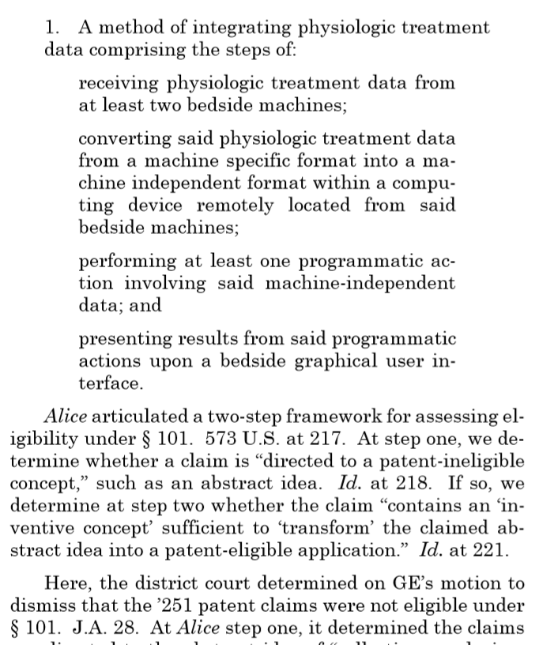
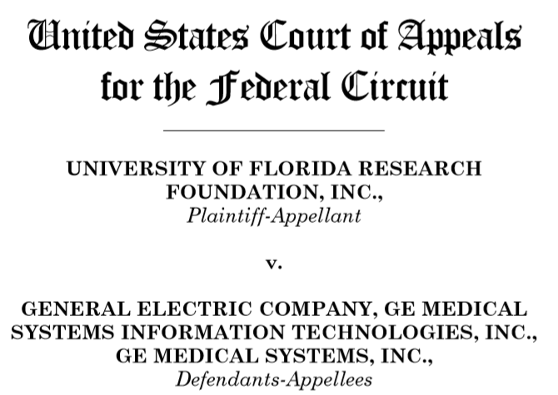
Us – Weak or strong patent system?
Federal Circuit -- 101

Slide 10
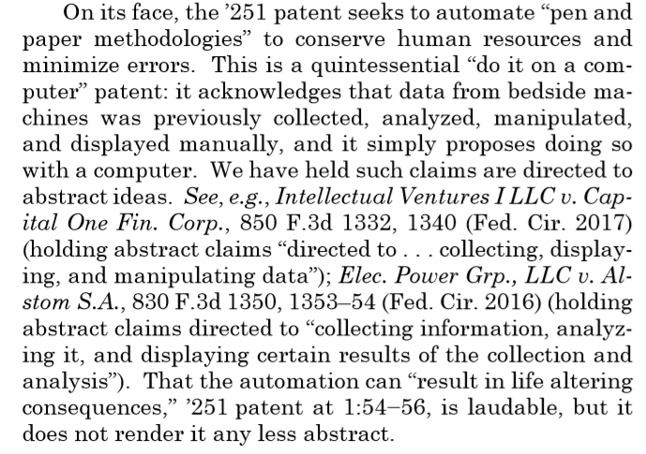
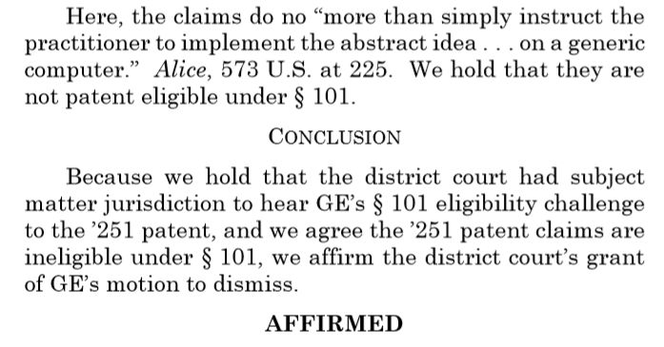
Us – Weak or strong patent system?
Federal Circuit -- 101

Slide 11
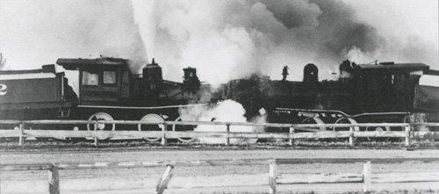
PTO and courts on a collision course?

Slide 12
Alice – 101 Fenwick & West tally (11/20/18):
Decisions upholding claims:
  PTAB 34
  Fed Cir 12
  D Ct 54
Decisions invalidating claims:
  PTAB 314
  Fed Cir 39
  D Ct 137

Slide 13
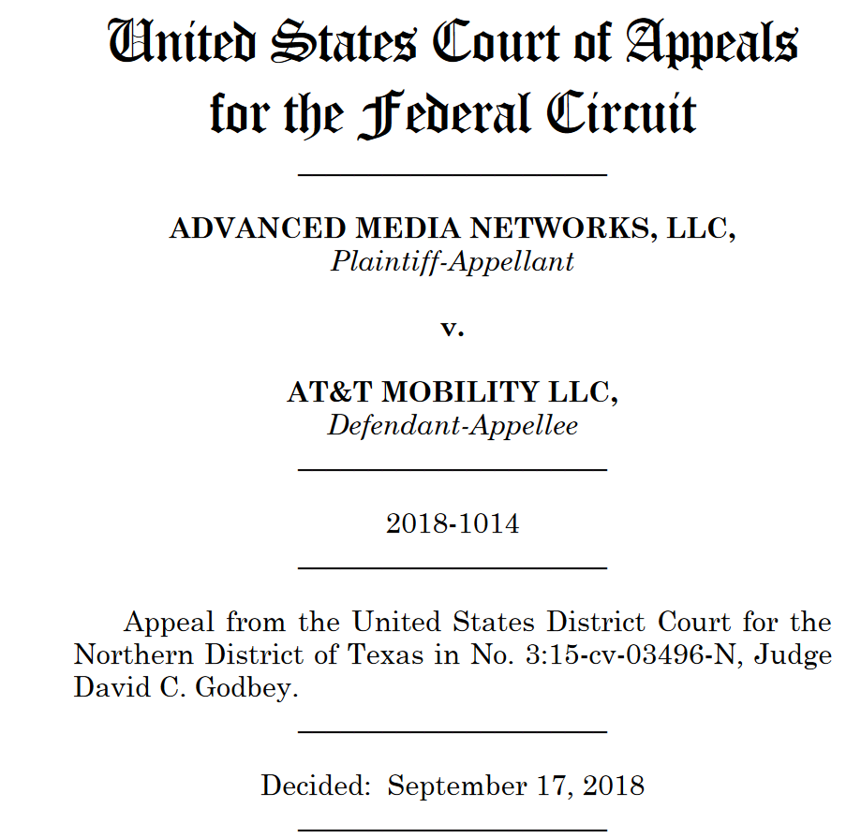
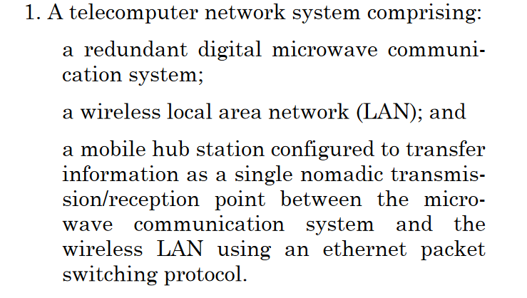
Inconsistent decisions

Slide 14
Inconsistent decisions

Slide 15
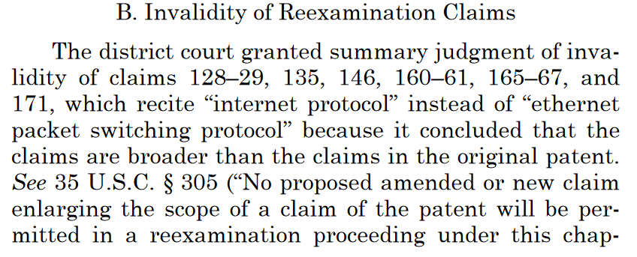
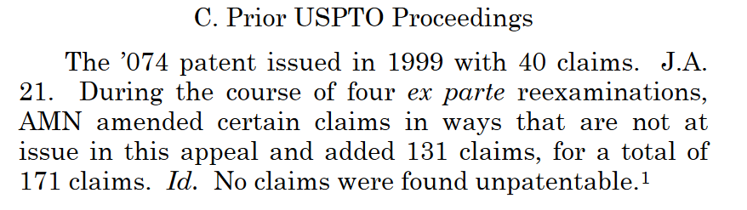
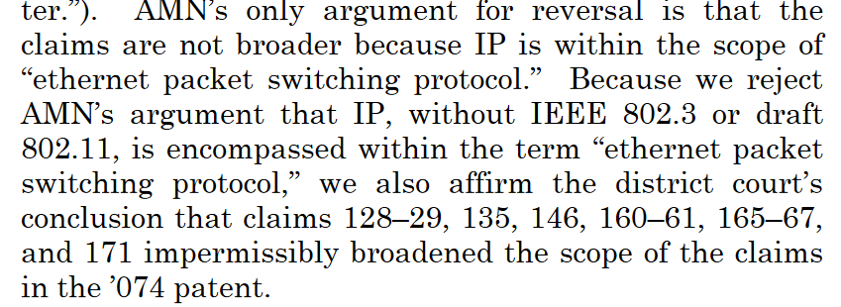
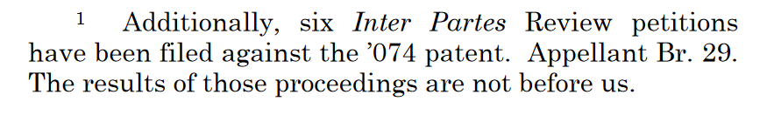
Inconsistent decisions

Slide 16
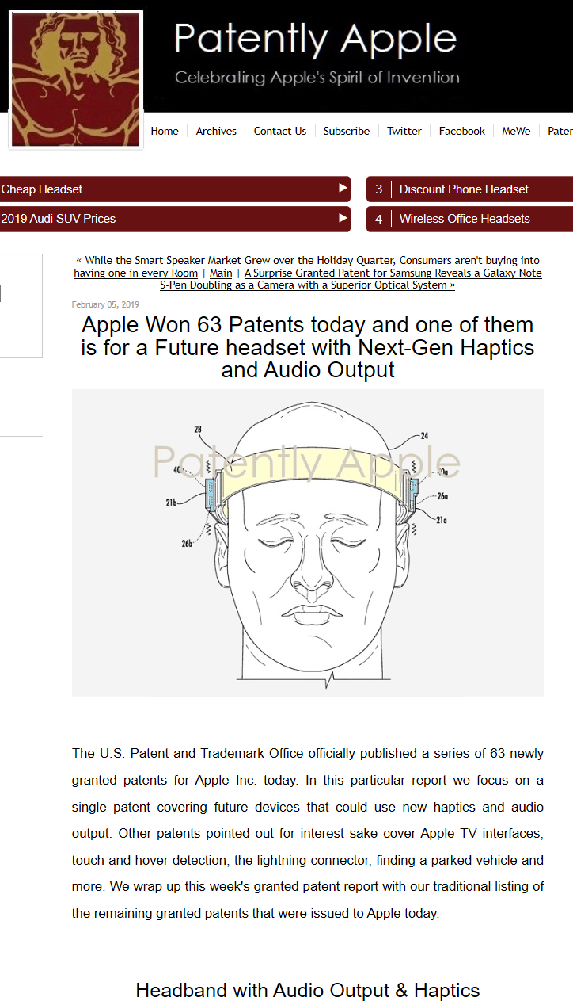
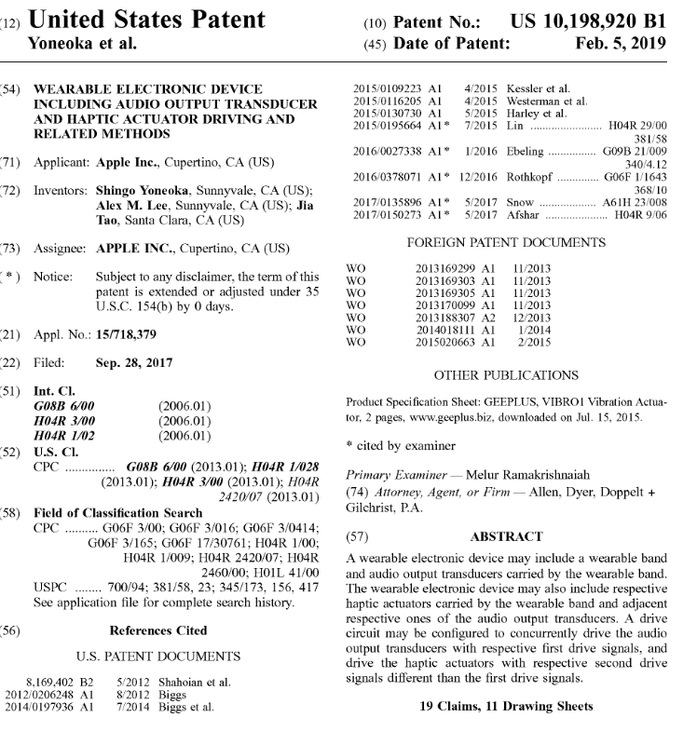
Regular folks don’t understand patents

Slide 17
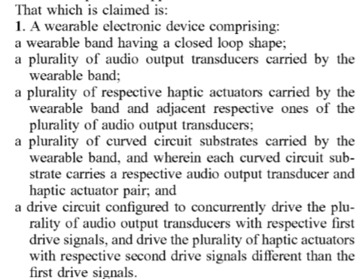
Regular folks don’t understand patents

Slide 18
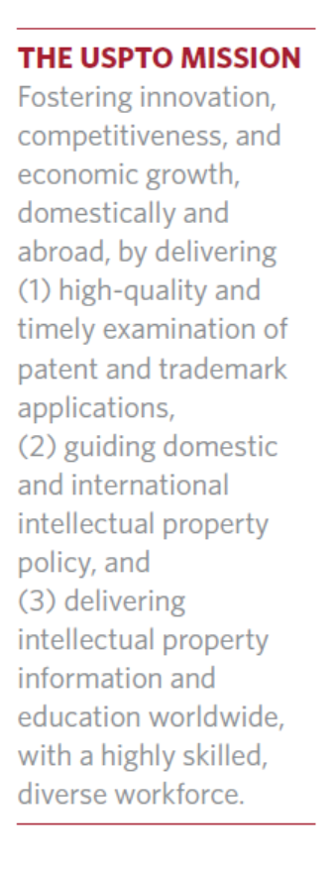
Uspto 2018 REPORT/mission

Slide 19
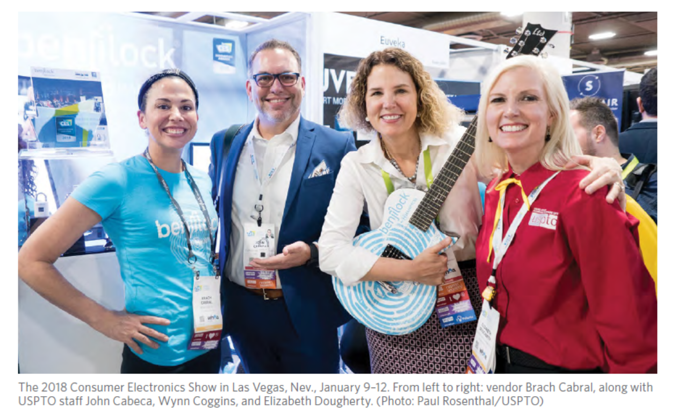
Patent office folks are normal

Slide 20
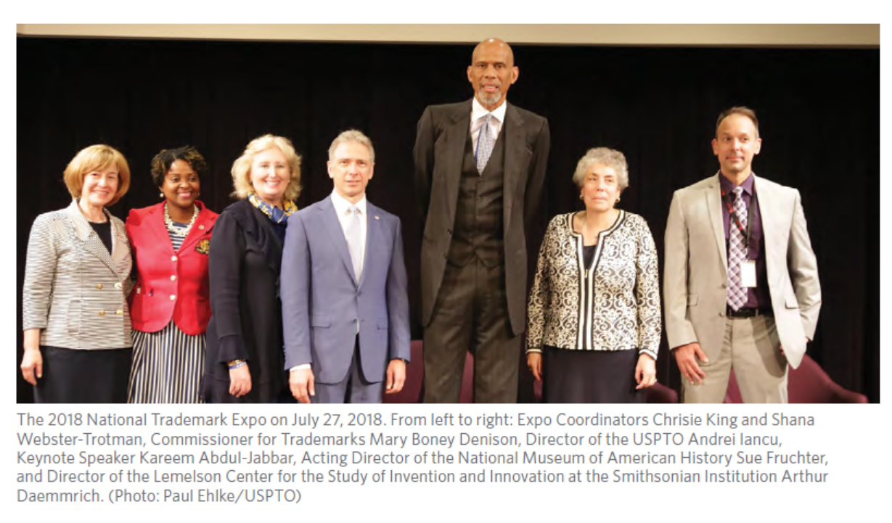
Trademarks folks are different

Slide 21
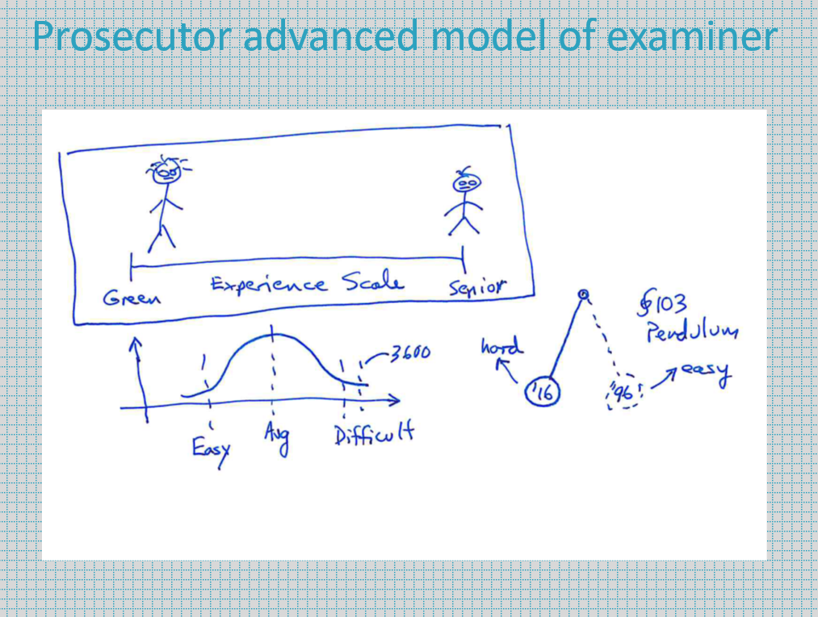
Examiner model still working

Slide 22
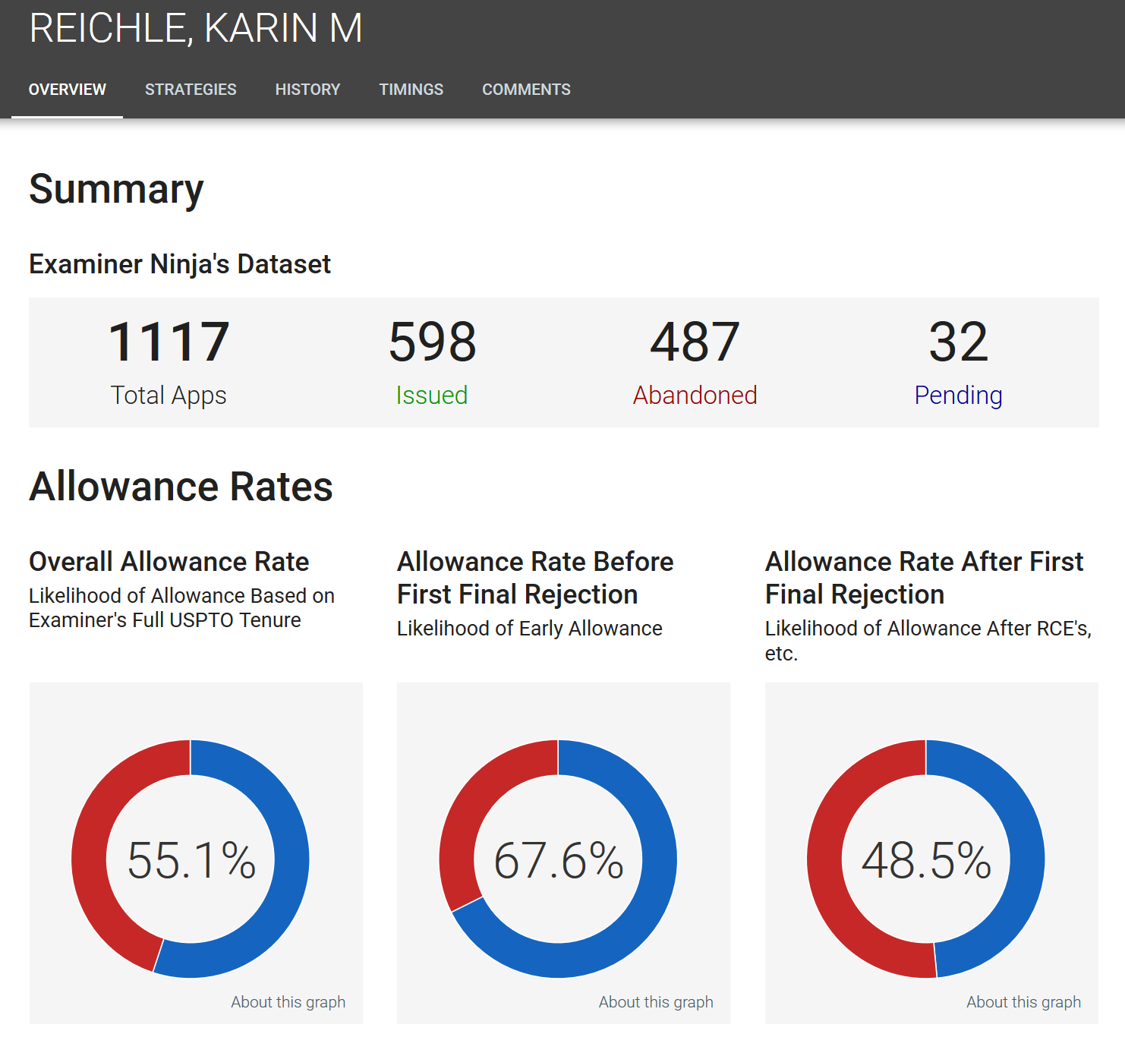
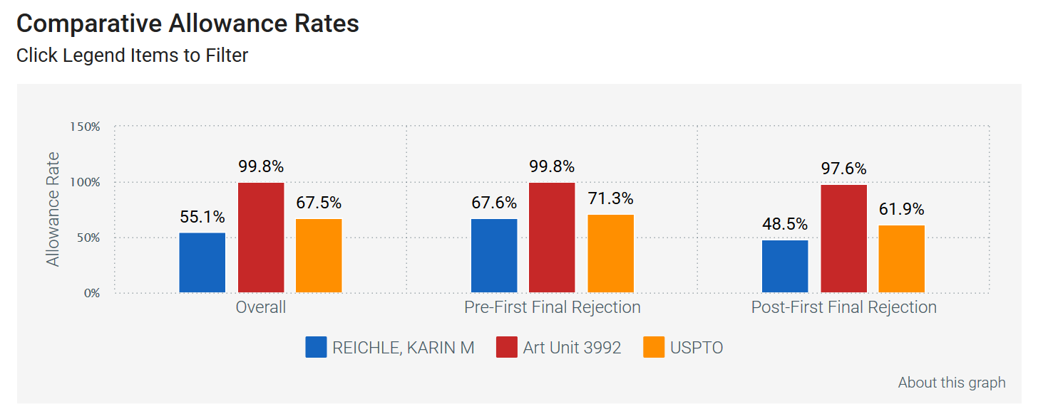
now have examiner analytics too

Slide 23
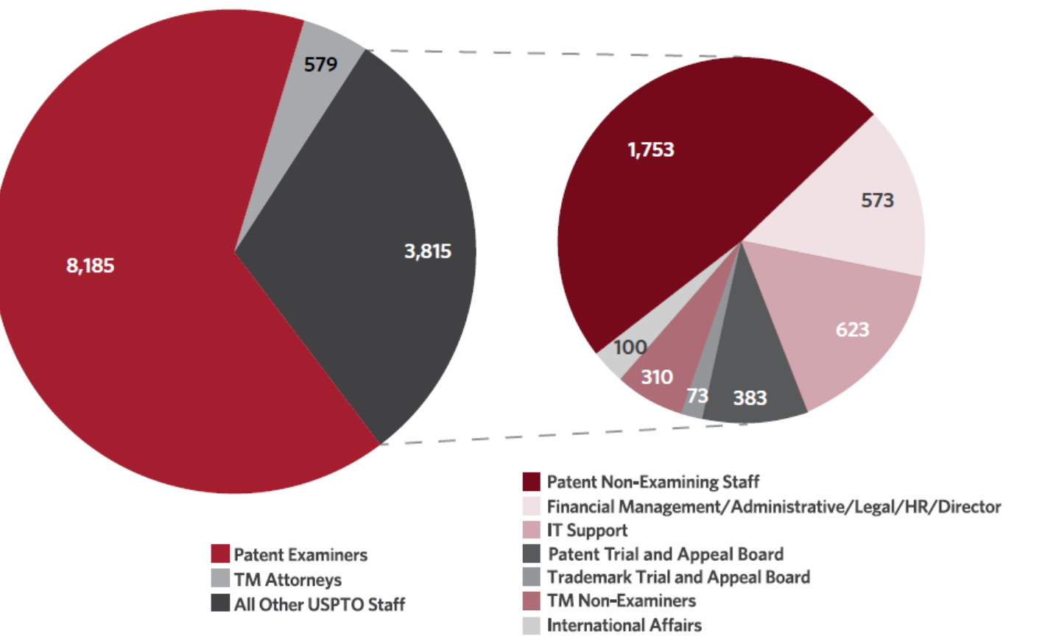
Uspto examiner numbers 2018 (less than 2016)

Slide 24
Uspto examiner numbers 2016 (more than 2018)

Slide 25
Uspto numbers from 2006
Note the number of Examiners

Slide 26
Pto Teleworkers

Slide 27
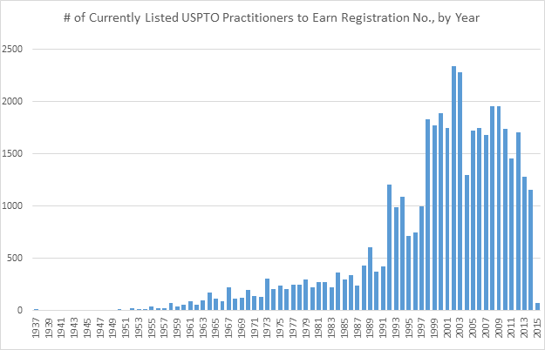
Uspto PRACTIONER numbers
The chart is new practioners per year.
Currently, there are 11929 active agents and 35053 active attorneys.

Slide 28
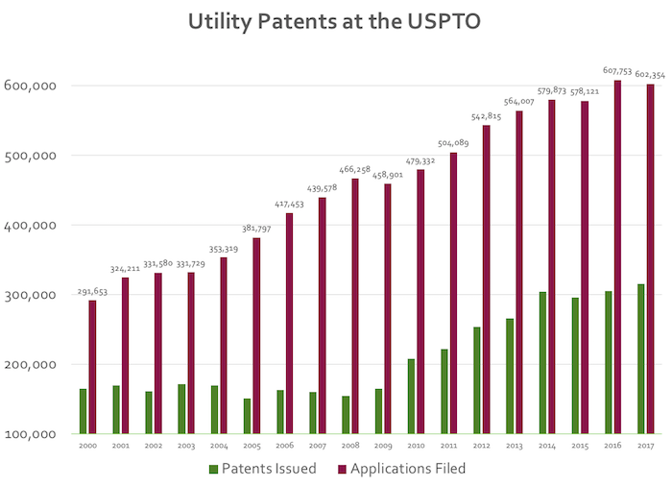
Uspto GRANT numbers

Slide 29
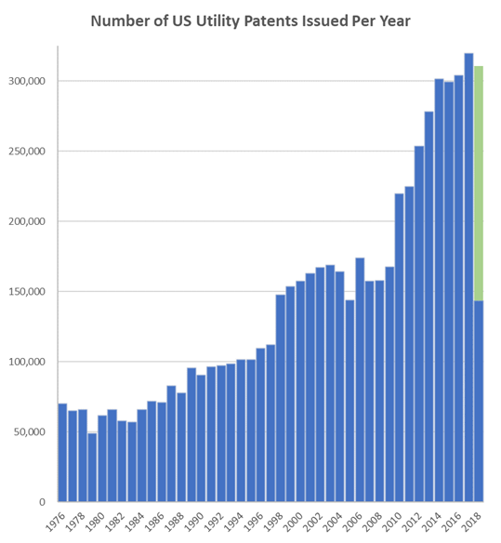
Uspto GRANT/filing numbers

Slide 30
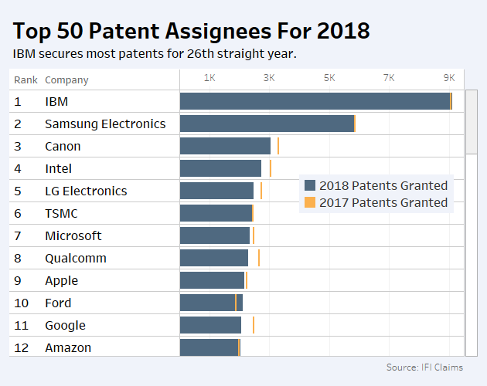
Uspto GRANT/filing numbers

Slide 31
Uspto numbers 2014-2018

Slide 32
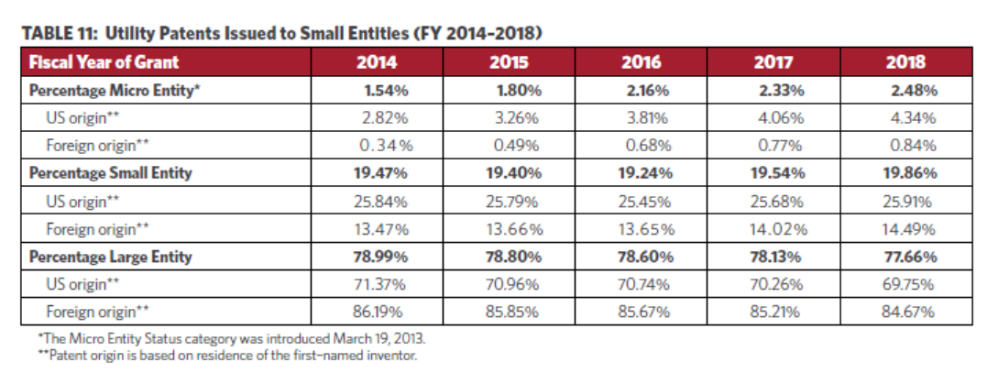
Uspto numbers 2014-2018

Slide 33
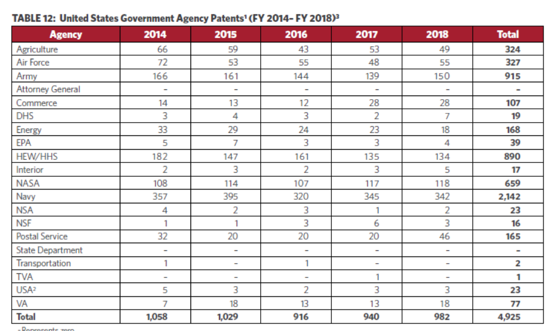
Uspto numbers 2014-2018

Slide 34
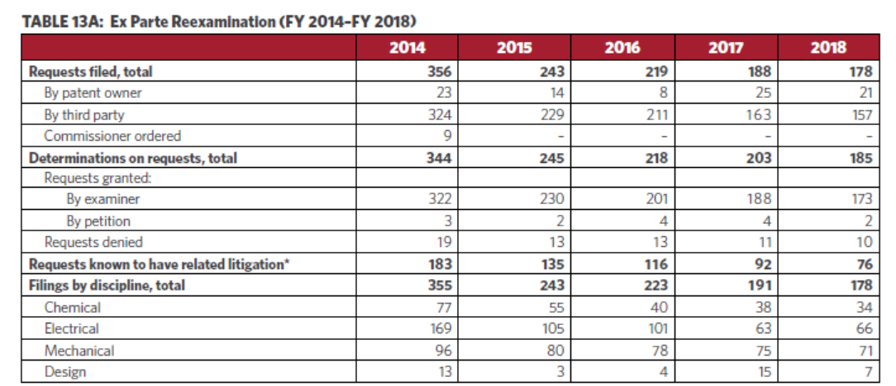
Uspto numbers 2014-2018

Slide 35
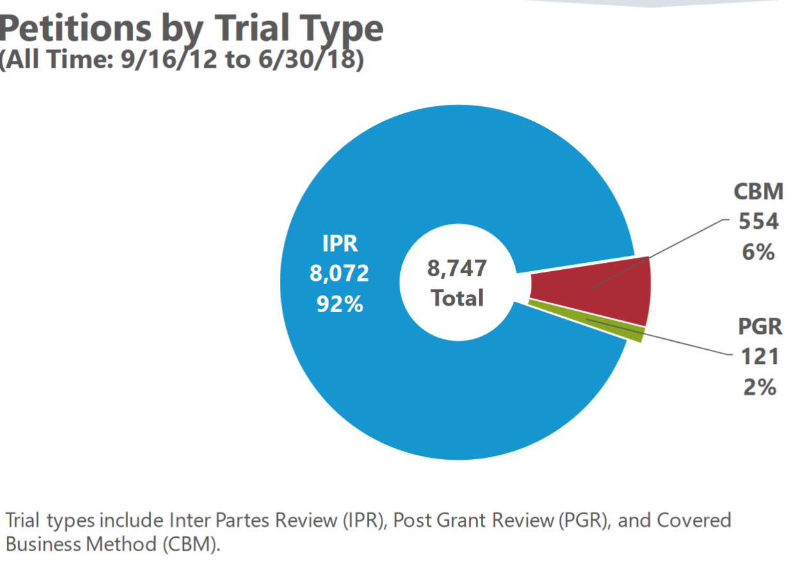
Uspto numbers death squad (pto june 2018)

Slide 36
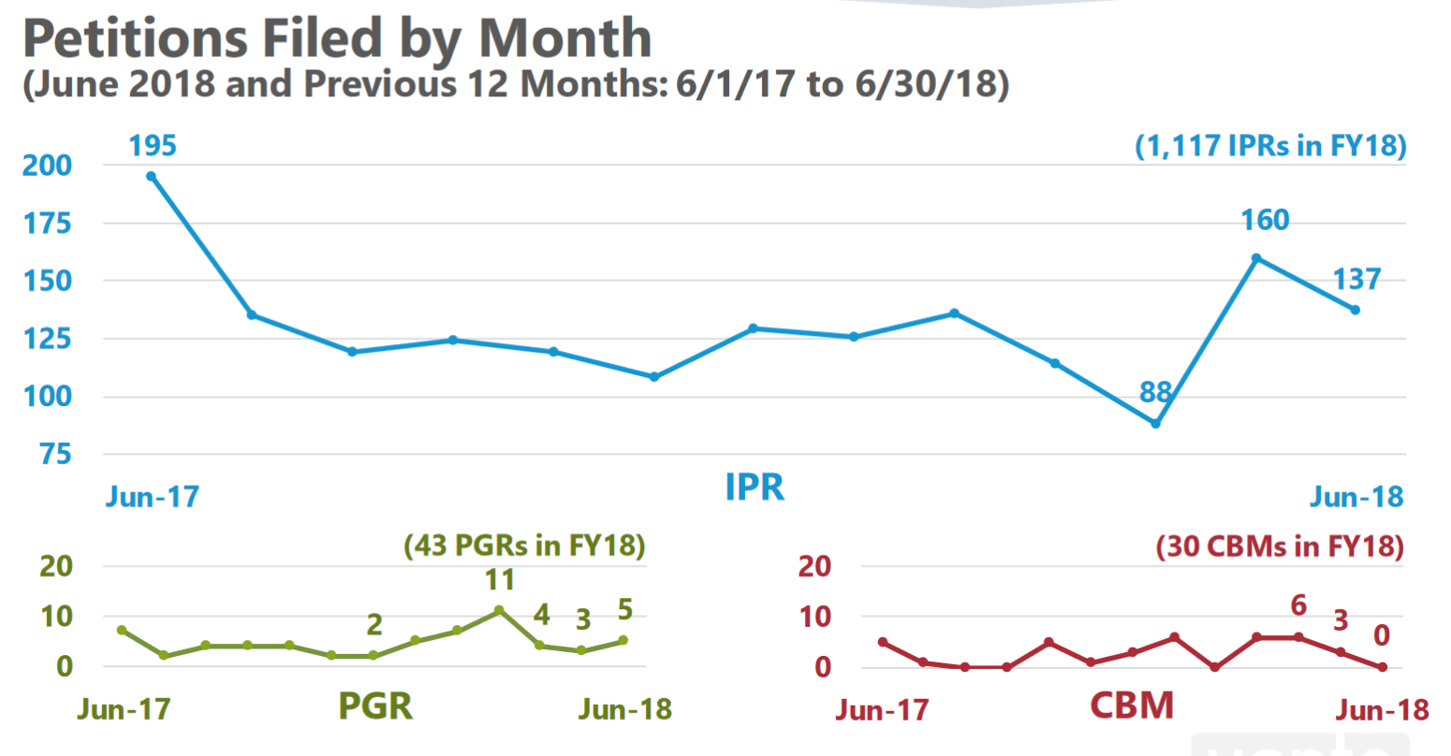
Uspto numbers death squad

Slide 37
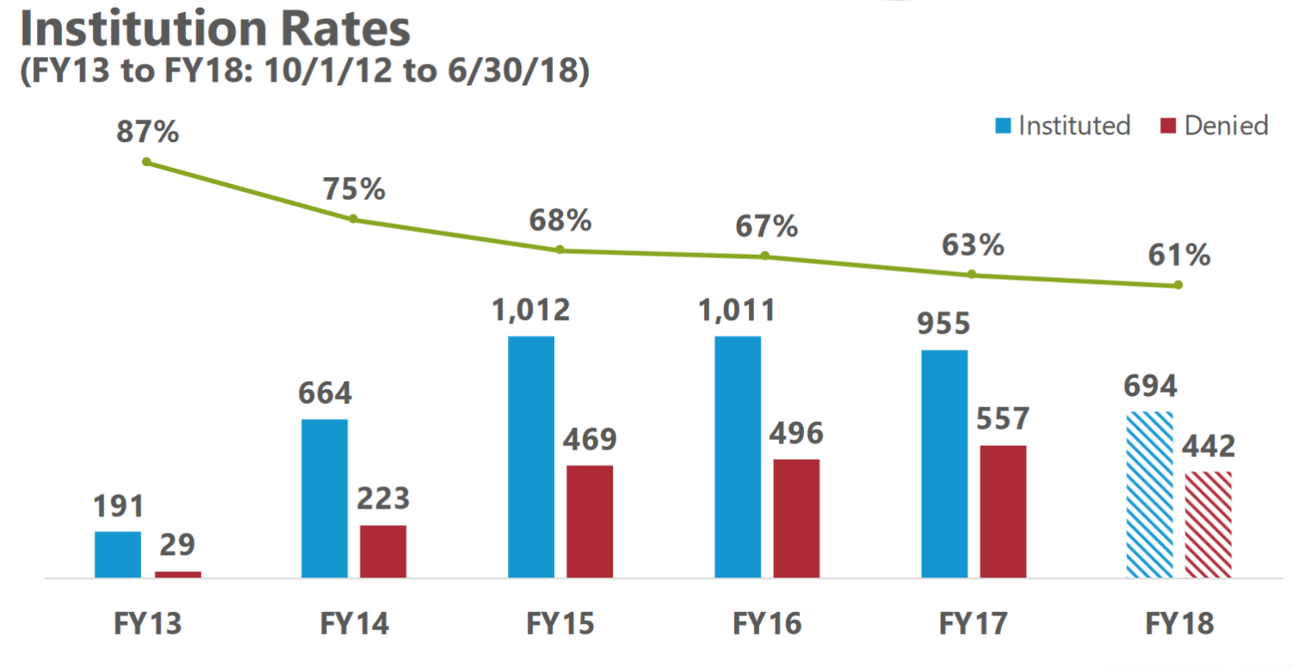
Uspto numbers death squad

Slide 38
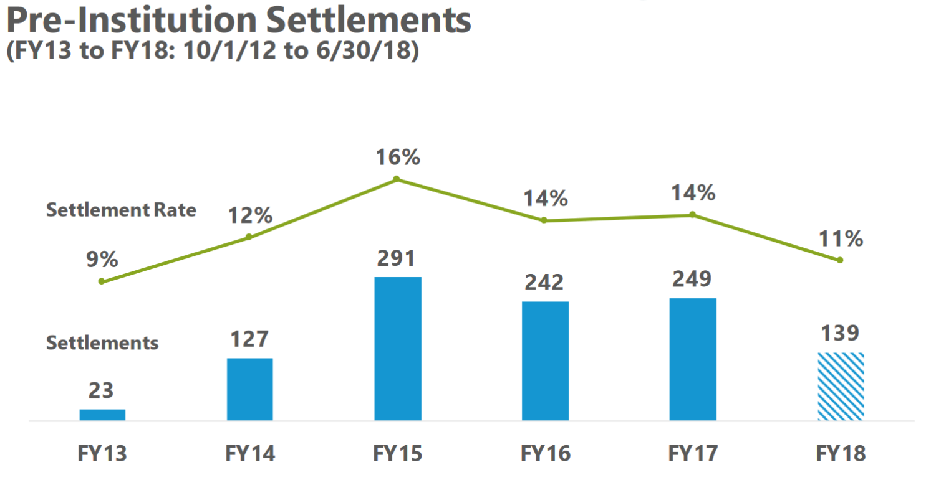
Uspto numbers death squad

Slide 39
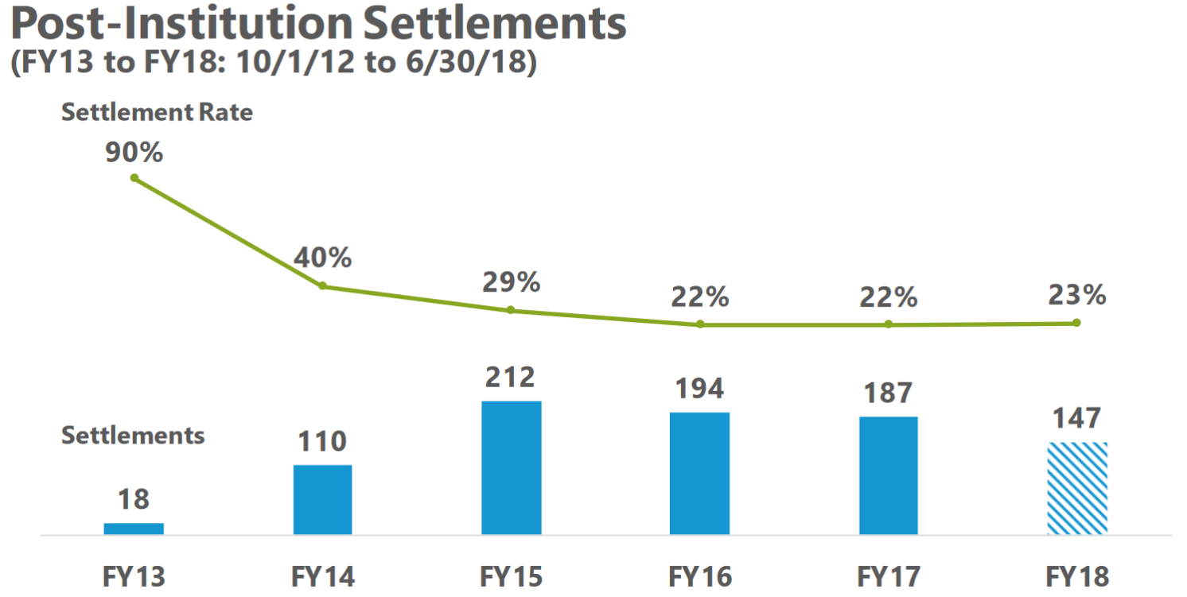
Uspto numbers death squad

Slide 40
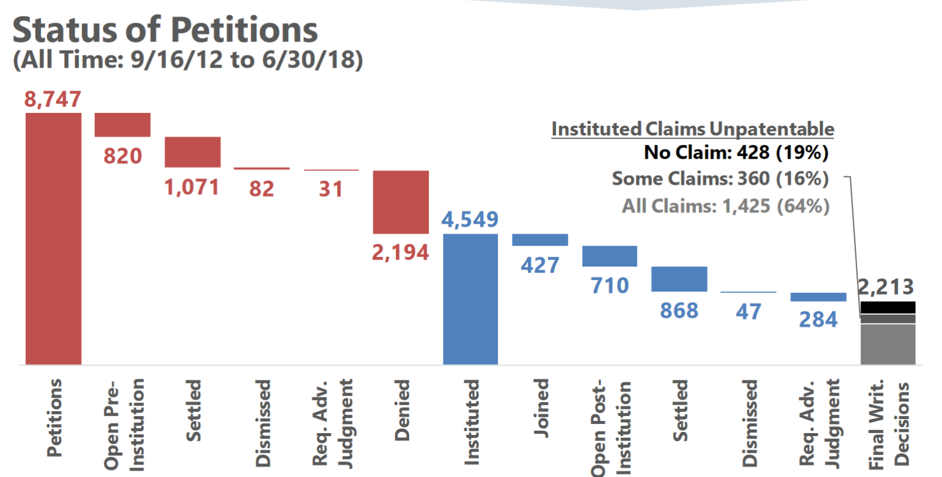
Uspto numbers death squad

Slide 41
Numbers (rpx 2016)

Slide 42
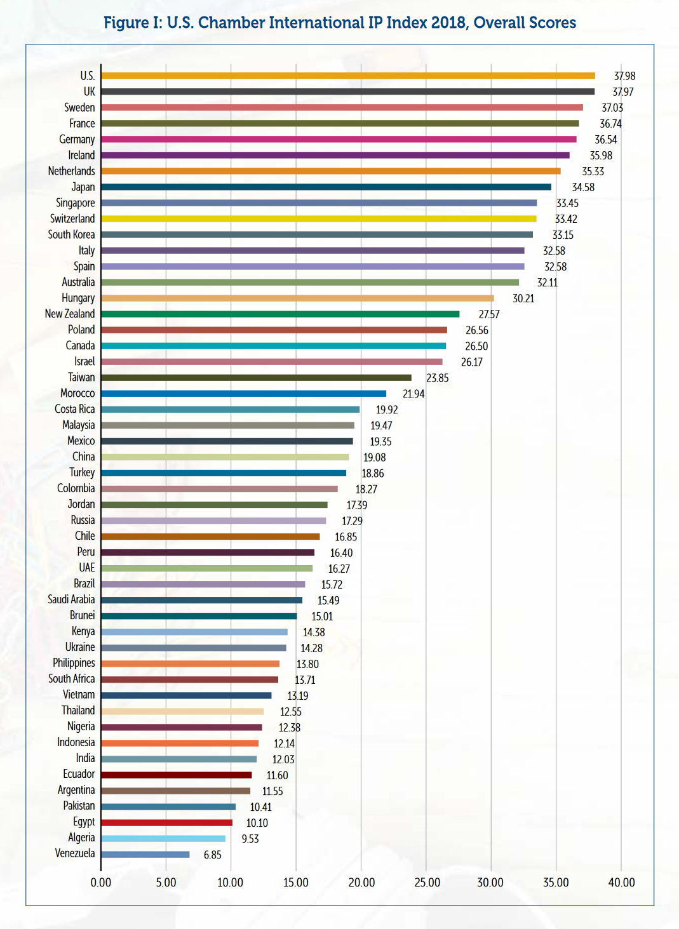
Us chamber of commerce rankings 2018

Slide 43
Questions from 2016?
Is the US Patent system weak or strong? -- Weak
  Encourage investment? -- Weak
  Relative to other countries? – Moving up in some rankings
Which direction is the US Patent system headed? – Better than 2016, still weak
What can be done to make it stronger?
  Modify or eliminate PTAB? Best chance at SCOTUS was lost. PTO is working on more favorable procedures
    Change procedures? Easier amendments? Phillips claim construction? Presumption of validity? Phillips claim construction now in IPR
    Return injunction as remedy? Don’t hear anything

Slide 44
end

