Slide 1
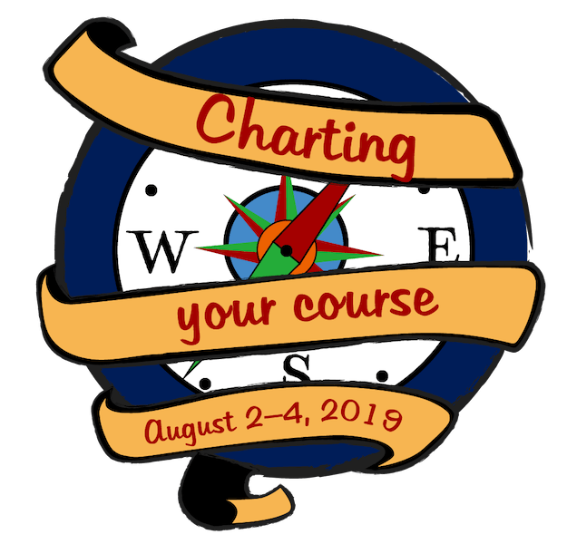
2019 FAPA Annual Conference & Book Awards Banquet
Charting Your Course
Hilton Orlando Buena Vista Palace
NAVAGATING THE LEGAL SEAS
August 3, 2019
Presented by:
Ava K. Doppelt, Esq.
Allen, Dyer, Doppelt & Gilchrist, P.A.
255 S. Orange Avenue, Suite 1401
Orlando, Florida 32801
407-841-2330
adoppelt@allendyer.com
www.patentamerica.com
https://allendyer.com/news-resource-center/educational-materials/

Slide 2
2019 FAPA Annual Conference & Book Awards Banquet
What’s been going on in writing and publishing this year?
According to the Frankfurter Buchmesse --
1 – Changing reading habits
Almost half of the global population is under 25
More than half of the world’s population are global internet users,
92% of whom watch videos online; 52% stream TV content
30% play livestreamed games
Transformation of the non-linear TV market
Disney/21st Century Fox Netflix
Apple Beijing ByteDance
Google
Is there time left for reading? (Reading what?)

Slide 3
2019 FAPA Annual Conference & Book Awards Banquet
2 – Digital books
A decade after e-books, publishers have learned how to exploit popular formats in addition to print
Consumer patterns are becoming more fluid and segmented
Consideration of what digital books can evolve into – not just a new format (hardcover, paperback) but something that complements existing manifestations and the value provided
Learning platforms
Streaming and audio books
Scientific research on differences between reading a book in print or on a screen, and listening to or watching a story

Slide 4
2019 FAPA Annual Conference & Book Awards Banquet
3 – Changing cultural practices
Publishing market has been flat this past year
Self-publishing has become a new industry segment of significant scope, though data is limited
Bankruptcies, mergers, takeovers
- Sale of Barnes & Noble to Elliot Management Corp.
- Baker + Taylor ending wholesale distribution

Slide 5
2019 FAPA Annual Conference & Book Awards Banquet
2019 US Book Industry Study Group – Michael Tamblyn’s history of bookselling -
1 - First, independent bookselling
2 - Then big box and chain bookselling
3 - Internet
4 - E-books
5 - Now – in the “attention economy” – books, reading, authors, publishers and retailers are competing against everyone else that connects with an audience – Netflix, YouTube, Apple, Amazon, Google, Alibaba, Tencent -- all provide media content to consumers
Publishers must learn to engage directly with their many different audiences.

Slide 6
2019 FAPA Annual Conference & Book Awards Banquet
Educational publishers – content can be broken down into learning objects, offered to a community of users on a platform, mixed up with user-generated content and monetized through subscriptions.
Speak directly to learners rather than teachers
Audio books – changes everything to a listener’s point of view
- Listen at different times of day
- New gadgets
- Open to broader genres
Thus, digital books engage the reader in significantly different ways –
Strong impact on comprehension and retention, thus on the effectiveness of the learning process
Simple and direct digital copies of printed books are finding only limited success.

Slide 7
2019 FAPA Annual Conference & Book Awards Banquet
Intellectual Property – Creations of the mind
Is the most vital and valuable asset in the business of publishing books.
Copyright is the most significant form of intellectual property relevant to writers and publishers.
In the United States, the law of copyright is based on a federal statute found at Title 17 of the U.S. Code, as well as the legal cases that interpret various sections of that statute.
Generally the first owner of the copyright in a work is the creator of the work – writer, artist, photographer, composer, choreographer, software coder, architect.
Therefore the publisher will have to enter into a legal relationship with the creator to publish the work and make copies to sell – the publishing contract.
The law relating to contracts is state law.

Slide 8
2019 FAPA Annual Conference & Book Awards Banquet
Grant of copyright rights –
1) Through outright assignment – publisher owns the copyright; author owns nothing but receives payment
2) Through exclusive or non-exclusive license of some or all rights of copyright
The copyright does not protect ideas; only expression.
Literary works often contain more than one copyright:
Illustrations
Photographs
Cover art
Introduction
Each is subject to a separate arrangement with the owner for its use and publication.

Slide 9
2019 FAPA Annual Conference & Book Awards Banquet
Trademarks – Brand names and logos.
- Important to identify your business, or a book series.
- Not for a single book, title or film
Copyright – Exists as soon as the work is fixed in a tangible form.
- Copyright registration is necessary only as a prerequisite to suit.
All works should contain a copyright notice, weather or not the copyright is registered.
Copyright protects new expression as well as the selection and arrangement of works that may be owned by others, or in the public domain.

Slide 10
2019 FAPA Annual Conference & Book Awards Banquet
Copyright owner has a bundle of exclusive rights, including:
- Right to reproduce the work (make copies)
- Right to distribute copies to the public
- Right to communicate the work to the public – display, perform, broadcast
- Right to make derivative works such as translations, adaptations
- Right to make the work available on the internet
Moral rights - paternity and integrity

Slide 11
2019 FAPA Annual Conference & Book Awards Banquet
Who owns the copyright?
Creator/co-authors
Work for hire
Assignee
Not the same as ownership of the physical work
Duration – In United States, life of author plus 70 years
Not covered by copyright:
- ideas and facts
- works of United States government
- works in public domain
- short phrases, titles, simple shapes

Slide 12
2019 FAPA Annual Conference & Book Awards Banquet
Fair use
No hard and fast rules
In the United States, four factors considered:
Purpose and character of the use
Nature of the copyrighted work
Amount and substantiality of portion used
Effect on market for copyrighted work
“Transformative”
Copyright infringement – use of a copyrighted work without permission, when it’s not fair use. Not required to be exact copy.
Not always the same as plagiarism – which is falsely passing off a work as your own.

Slide 13
2019 FAPA Annual Conference & Book Awards Banquet
Common Legal Issues in Publishing and How to Avoid Them
No such unified legal subject as “publishing law.”
Copyright challenges
The most valuable asset of most publishers is the copyrighted content of their books.
Enables publishers to control content, and therefore sell books and subsidiary rights

Slide 14
2019 FAPA Annual Conference & Book Awards Banquet
Publishers can be liable for the omissions, mistakes and transgressions of their authors, as well as their own. They protect themselves by:
Representations and warranties
Indemnification
Independent legal review
Insurance

Slide 15
2019 FAPA Annual Conference & Book Awards Banquet
Defamation, privacy, publicity issues
Understand defamation, privacy and publicity issues – conduct own legal review, even if author warrants that work has no problems
Negligent publication
Confirm author’s credentials and expertise
Again, check accuracy even if author is responsible under the contract
Disclaimers
Insurance

Slide 16
2019 FAPA Annual Conference & Book Awards Banquet
Electronic and digital uses
NY Times v. Tasini (S.Ct. 2001) Re-use of freelancers’ articles in text-only database was not included in grant of serial rights
Random House v. Rosetta Books (N.Y. 2001) “Book form” does not include ebooks
Contract challenges
Accurate
Clear and unambiguous
Comprehensive and complete
Specific
Fair and reasonable
Satisfaction clause
Sub rights licenses
Agreements with distributors, resellers

Slide 17
2019 FAPA Annual Conference & Book Awards Banquet
1 – Author Grants
First step in publishing process is to properly obtain rights from authors. Two ways:
1) Exclusive license of some or all rights
2) Assignee of copyrights, i.e., complete ownership
2 – Copyright procedures
1) Copyright notice
2) Copyright registrations
3 – Copyright licenses/grants of subsidiary rights
4 – Protect against committing infringement
Due diligence of authors
Comprehensive author warranties and representations
Understand fair use

Slide 18
2019 FAPA Annual Conference & Book Awards Banquet
Recent Cases Involving Publishing and Writing
TD Bank v. Hill (3rd Cir. July 2019) Ex-CEO of bank transferred copyright in his memoir to bank, which never published it. He left and wrote his own memoir (16% infringing). Trial court enjoined him from selling it. Appeals court just reversed.
Ga. State Library Copyright Suit (GA, 11th Cir.) 11 years of litigation, still ongoing, over weather book excerpts available to college students for free on “e-reserve” violated copyright law or were fair use.
Nicassio v. Viacom (PA, 2018) Children’s book author’s claim of copyright infringement against book and animated series with similar plot line, about an antimorphic Christmas tree with big dreams, was dismissed because plot and themes were too generic to be protected by copyright.
#Cockygate (2018) Romance writer trademarked “cocky” for series of romance books, then got Amazon to take down other authors’ books with “cocky” in their titles.

Slide 19
2019 FAPA Annual Conference & Book Awards Banquet
Recent Cases Involving Publishing and Writing
Authors’ Guild v. Lexis/Nexis - Class action filed by 3000 freelance writers in 2001 for using their articles in Lexis/Nexis database. Writers finally began receiving their share of the settlement ($9 million) in 2018!
Series of Copyright Infringement Suits Over The Use Of One Photograph (Mostly NY, but FL as well) Photographers working with copyright troll lawyers who scan the internet for uses of their photos, and file hundreds of lawsuits -- most of which are settled for five figures.

Slide 20
2019 FAPA Annual Conference & Book Awards Banquet
Natasha Tynes vs. Rare Bird Lit (CA 2019) Tynes tweeted a photo of a black female transit worker on the DC Metro, and encountered widespread backlash; her publisher said it was “horrible” and cancelled her book contract. She is suing them for $13.4 million for breach of contract, defamation, emotional distress.
Thomas Nelson (TN 2019) $15 million verdict against Nelson for fraudulently terminating contract with printer.
Jay Asher vs. Society of Children’s Book Writers and Illustrators and Lin Oliver (CA 2019) Defamation suit after Asher was accused of sexual misconduct.
Nora Roberts vs. Christine Serruya (2019) Suit for “multi-plagiarism” on a “rare and scandalous” level.
Wiley, Cengage, Pearson, McGraw-Hill (2018) won $34.2million in lawsuit against Book Dog Books for selling counterfeit textbooks.
Mindew v. Wiley (2015 CA) Photographer’s agent could sue Wiley for printing more books than photograph license allowed.

Slide 21
2019 FAPA Annual Conference & Book Awards Banquet
Defamation and Invasion of Privacy
Defamation- published false statement of fact that injures a live person’s reputation.
Truth is a defense. Opinions are NOT defamation. Actionable even if the person isn’t named, and identifying details are changed, so long as recognizable (Nude Marathon therapy case)
Invasion of Privacy- Public disclosure of TRUE private facts about a live person, not related to public concern.

Slide 22
2019 FAPA Annual Conference & Book Awards Banquet
CASE Act
Pending legislation to create a small claims court for copyright claims -- a less expensive route for small copyright owners to sue for infringement (for disputes up to $30k in damages).

Slide 23
The End

