Slide 1
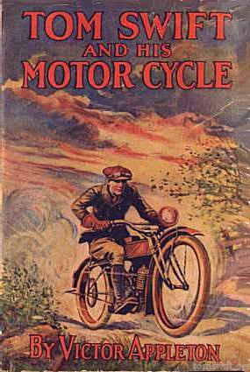
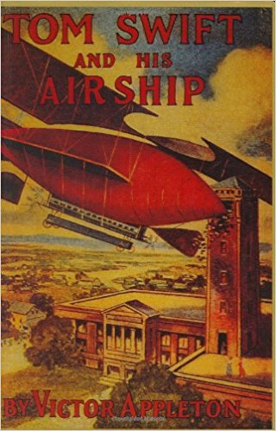
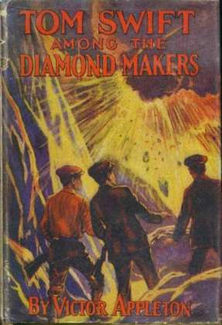
WHAT THE TASER, INVENTOR TOM SWIFT, THE JOURNALIST H.L. MENCKEN AND SUPREME COURT JUSTICE WILLIAM O. DOUGLAS HAVE IN COMMON

Slide 2
POP QUIZ
WHO IS THIS MAN?
AND
WHAT IS HE HOLDING?

Slide 3
A FLASH OF GENIUS?
HEARS STORY OF MAN THAT RUNS INTO AN ELECTRIC FENCE AND SURVIVES. WHY CAN’T THAT NON-LETHAL ELECTRIC FORCE BE USED TO STOP BAD GUYS WITHOUT KILLING THEM?
IS THIS A FLASH OF GENIUS FOR AN INVENTOR, MAKING JUSTICE DOUGLAS HAPPY? BUT – THE COMPLETION (REDUCTION TO PRACTICE) TOOK FIVE YEAR. DOES IT VINDICATE BOTH JUSTICE DOUGLAS AND THE SEC. 103,
“PATENTABILITY SHALL NOT BE NEGATED BY THE MANNER IN WHICH THE INVENTION WAS MADE.”

Slide 4
Tom Swift and his Electric Rifle
Make up a middle initial – Thomas A. Swift
TASER
It was the age of the inventor. Inventors and Patent Attorneys are in the public eye.
Compare the 40 year technological & scientific progress:
1865 to 1905
1977 to 2017.
Sherman slashes his supply lines, disappears within the borders of one of the original 13 states with 60,000 men like Caesar of old marching in Gaul. God knows where and poor President Lincoln paces the floor and exclaims he can still win the war if Sherman’s army is lost.
Published in 1911

Slide 5
SHERMAN DISAPPEARS WITH 60,000 MEN
THE FIRST MODERN WAR - BUT
CONFEDERATE GENERAL JOE JOHNSTON:
I MADE UP MY MIND THAT THERE HAD BEEN NO SUCH ARMY IN EXISTENCE SINCE THE DAYS OF JULIUS CAESAR.
THE LAST ANCIENT WAR
COMPARE THE TWO 40 YEAR SPANS
MASSIVE CHANGES TO 1905
MINOR TO 2017 - EXCEPT
MAYBE BIOTECHNOLOGY – BUT
1977 Genentech, Inc., reports the production of the first human protein manufactured in a bacteria: somatostatin, a human growth hormone-releasing inhibitory factor. For the first time, a synthetic, recombinant gene was used to clone a protein. Many consider this to be the advent of the Age of Biotechnology

Slide 6
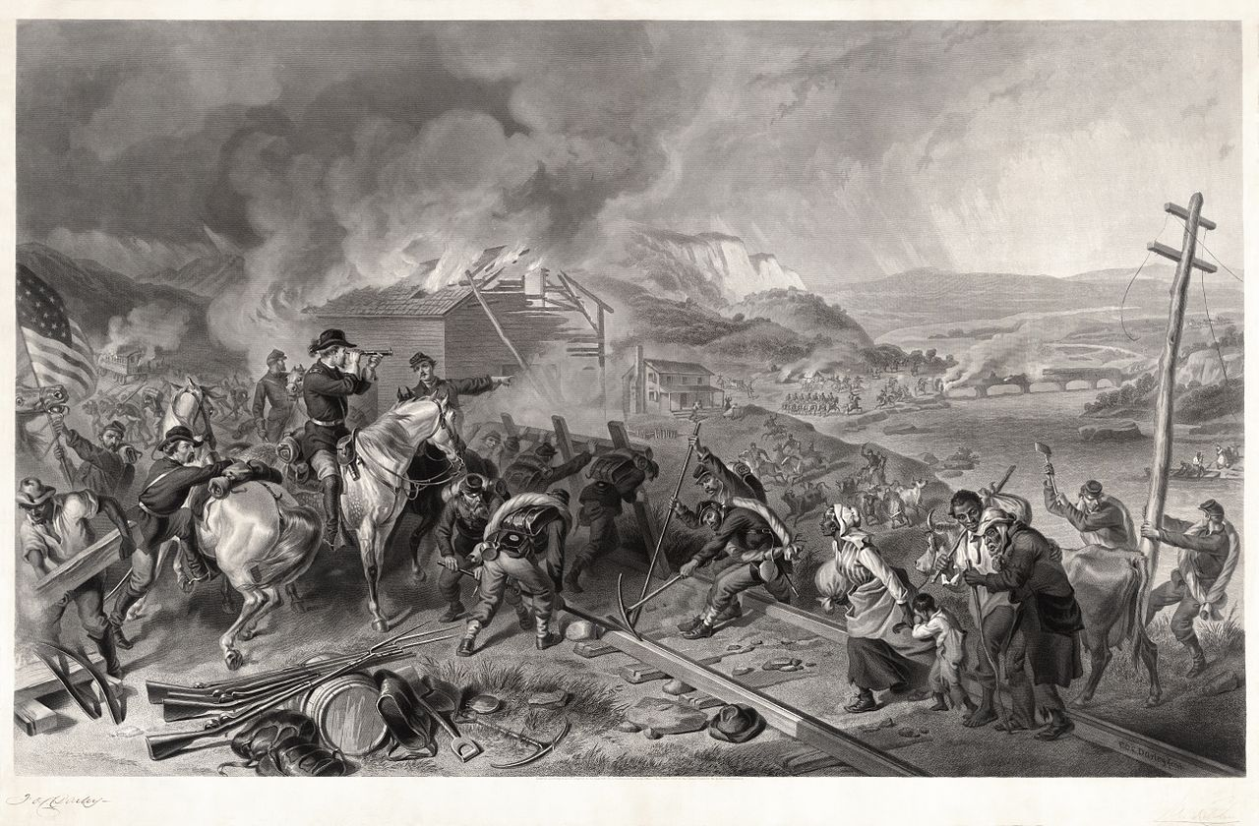

Slide 7
THE INFLUENCE OF INVENTIONS FROM 1865 TO 1905
A Yankee executive engineer visits Atlanta from the Ashes, “The Phoenix,” in the late 1800’s. He is an old Union veteran of Missionary Ridge and Kennesaw Mountain, but he brings not fire and destruction, but new designs for common-battery boards using indicating lamps and 10,000 line offices with trunking arrangements using separate A and B boards to interconnect offices. The Rebs make fun of him and joke they remember him and almost blew his head off on Missionary Ridge. He laughs and jokes it is good they were lousy shots. The Rebs and Yank are both more interested in telephone switching systems and the Rebs invite Yank to get some grub with them and bring those switching plans with him so they can figure out together how to implement the new design in Atlanta. Massive technological improvements and the esteem of inventors that were tall and short, young and old, educated and non-schooled, and Yank and Reb helped give healing balm to the soul of the country. Some would argue opposite, of course.

Slide 8
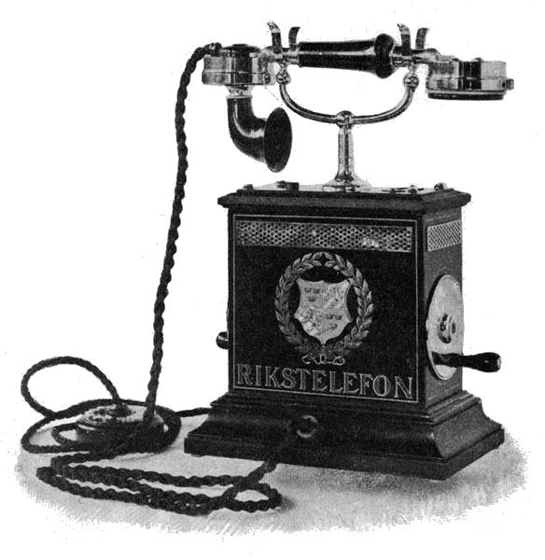
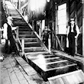
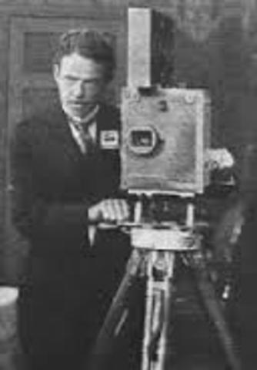
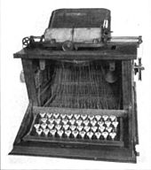
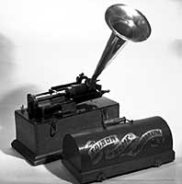
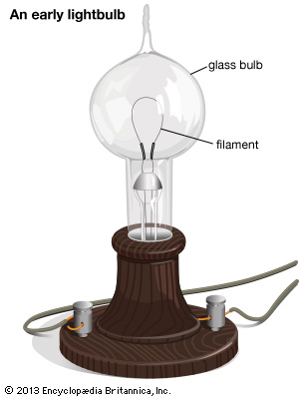
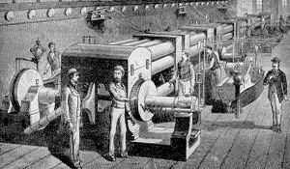
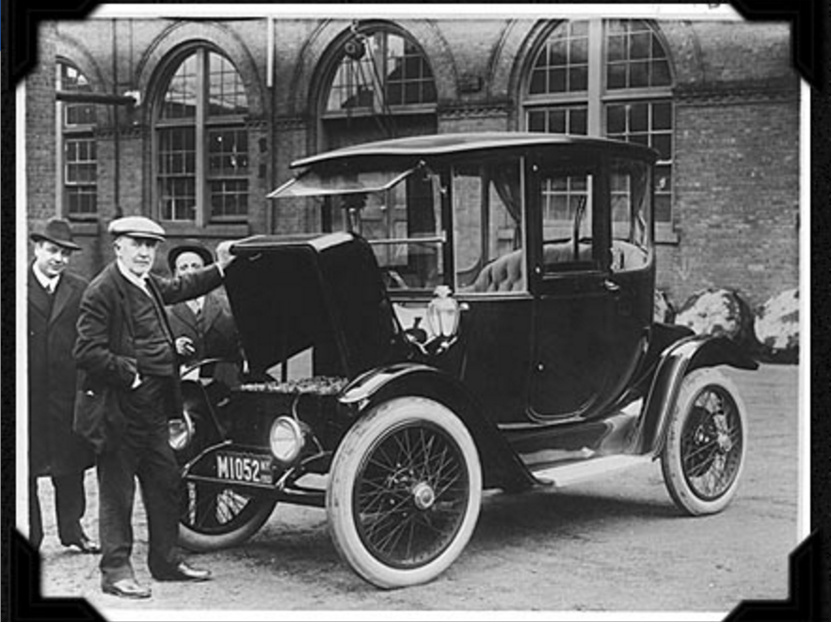

Slide 9
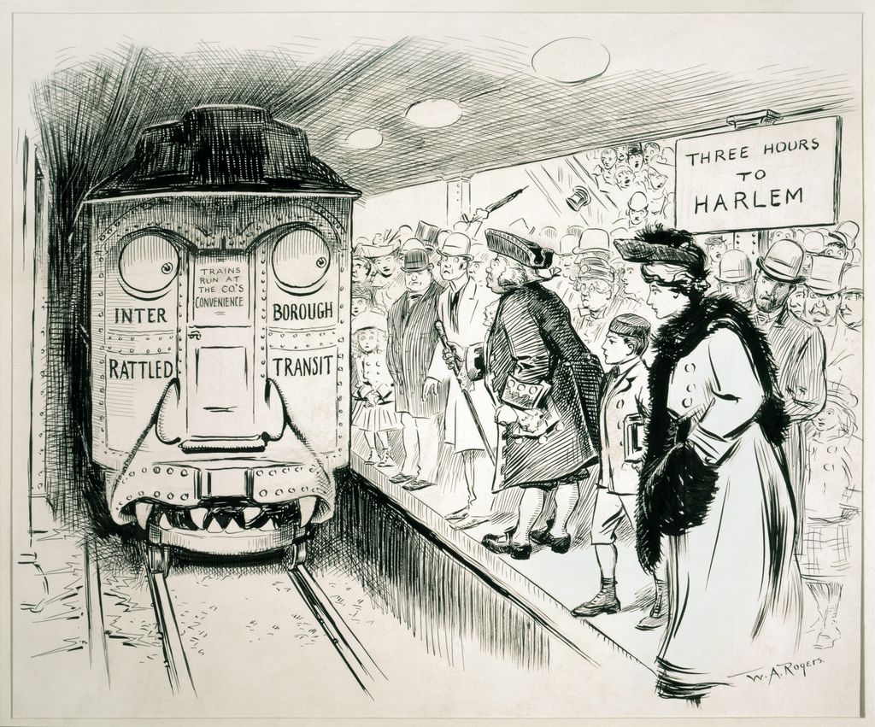
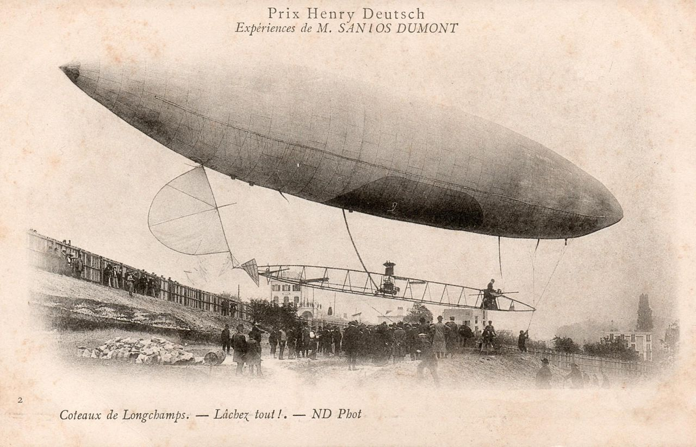
1905
cartoon
The Dumont Airship 1901

Slide 10
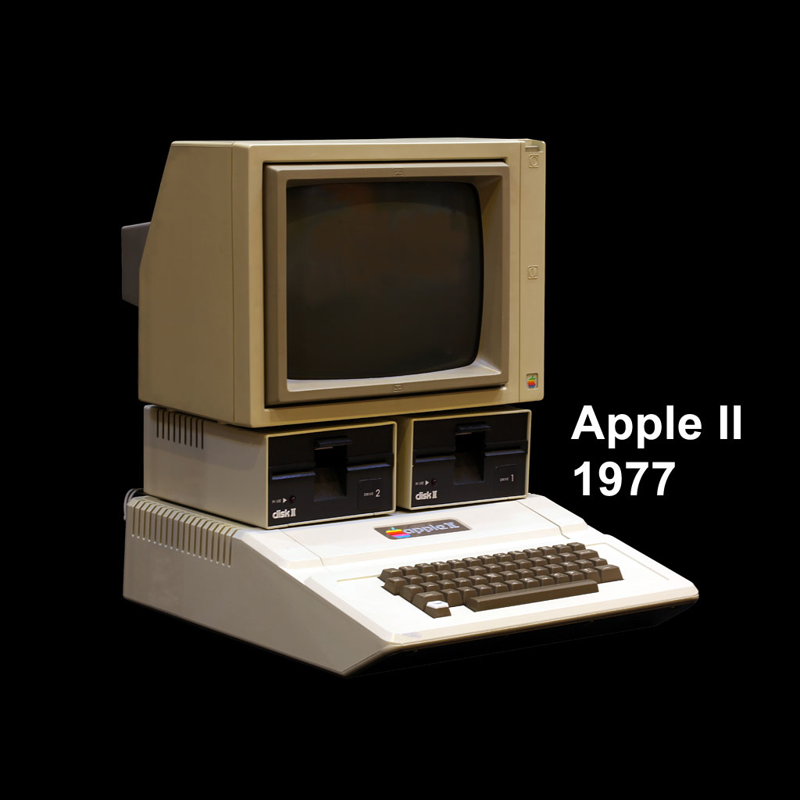
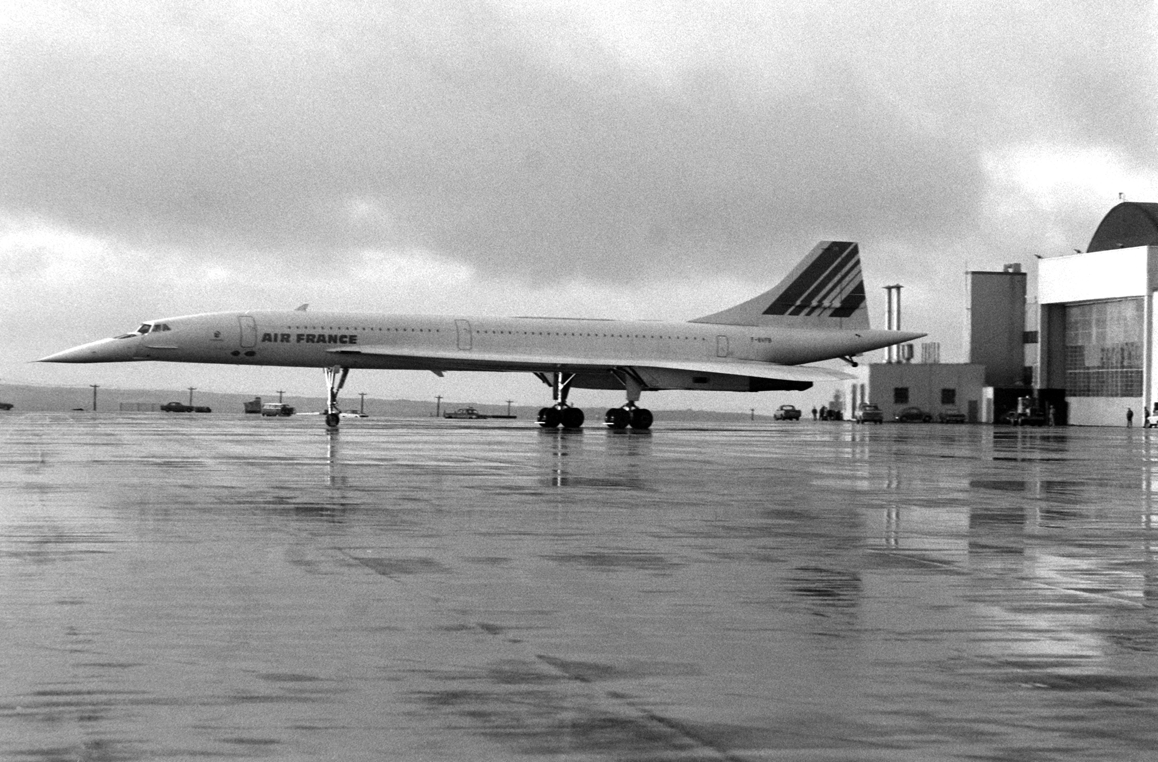
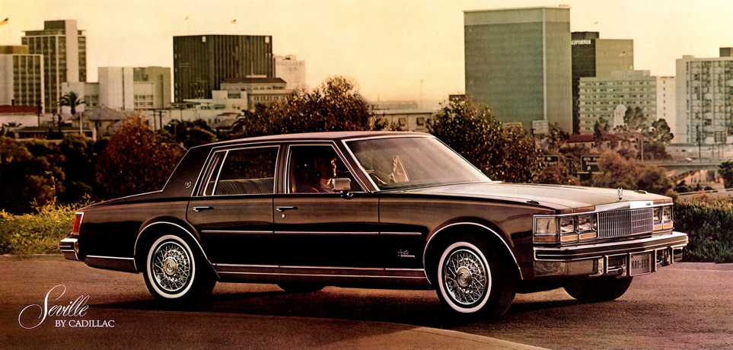
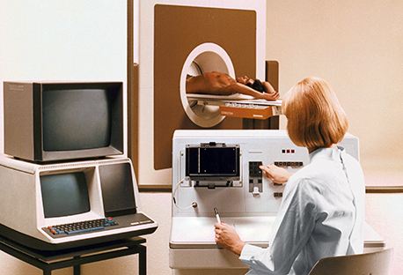

Slide 11
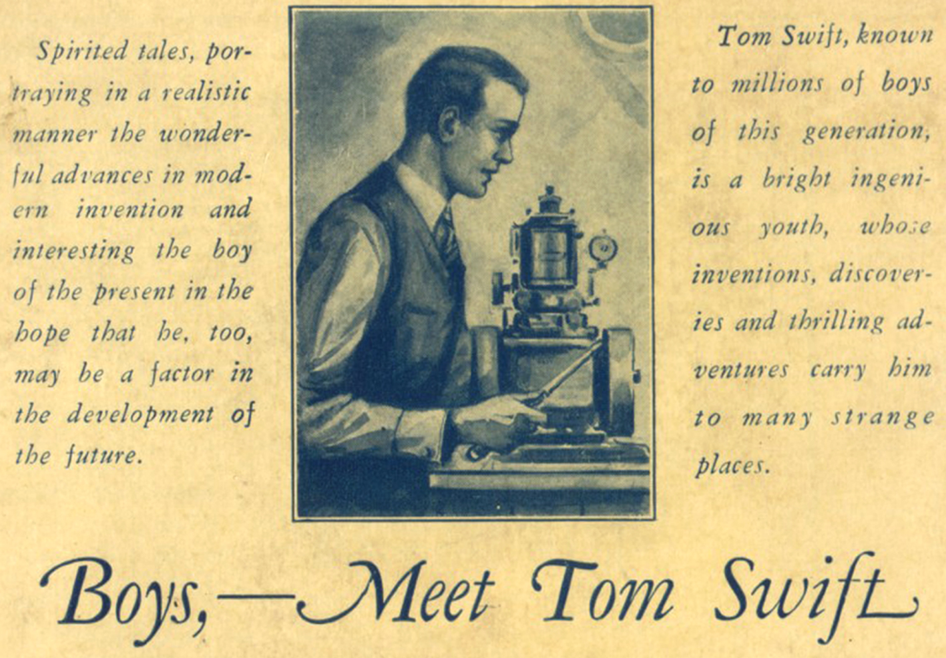

Slide 12
TOM SWIFT INVENTS THE FAX MACHINE IN 1914
TOM SWIFT REPRESENTS THE COMING OF AGE OF A YOUNG AMERICA AS THE WORLD’S HOTBED OF INVENTORS
MANY PATENT INTERFERENCES
THE RIGHTS OF INVENTORS – A PRIVATE RIGHT AND TOM SWIFT PROTECTS HIS INVENTIONS FROM THOSE EVIL MEN THAT WOULD INFRINGE OR STEAL HIS INVENTIONS
WORLD WAR I STARTS
LIFE MAGAZINE MAY 1964 50 YEAR WWI HISTORY ARTICLE

Slide 13
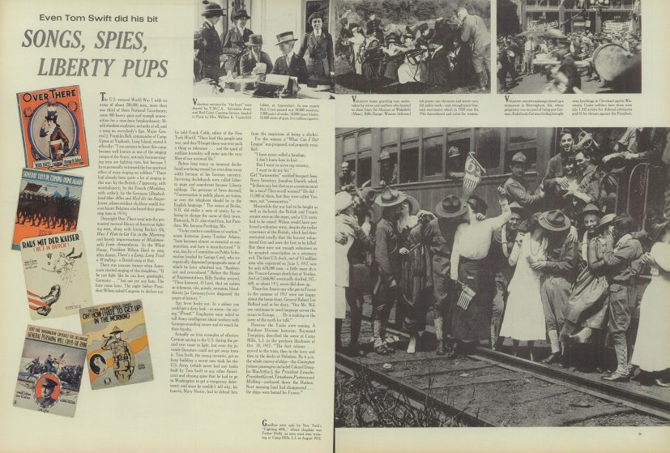

Slide 14
OR “Doing His Bit for Uncle Sam”
As Wiki Notes:
When the United States joins in The Great War, it seems that everyone has war fever. A military base close to Shopton is training soldiers in the art of trench warfare, while pilots are learning aerial combat. Ned Newton has quit his job to sell liberty bonds full-time. Many of the young men have enlisted, or even hoping for the draft. Everyone seems to be doing their bit, except for Tom Swift, which raises many concerns that Tom is a slacker.
Tom does not let his country down; the reason he appears to be idle is that he has secretly been developing a new tank for use in combat. The project is so secret that Tom does not even let his close friends know, which causes the concerns being raised about Tom's patriotism. Even though the development is in secret, that does not stop German nationals from trying to steal his tank
Tanks are a new wartime technology, and the British Army has deployed them for use on the western front. Tom's tank is bigger, and able to travel at twice the speed of current models, with a max of 12 miles per hour (19 km/h). At the expense of limited firepower with four unspecified machine guns, the tank has heavier armor plating than the British tanks.
Tom further refines the tank with an innovative built-in bridging mechanism, which will allow the tank to roll over wider trenches than the existing models.
Published Early 1918

Slide 15
H.L. MENCKEN – ALSO DOING HIS BIT FOR UNCLE SAM
Mencken – He Had His Issues – but –
Author of The American Language (1919), first scholarly work describing how the English language is spoken in the U.S.
Editor of The Smart Set (I would say The Smart Ass Set) & Founder of The American Mercury
Key character in the play and movie, Inherit the Wind.
Typical example of Mencken: In 1931 the Arkansas legislature passed a motion to pray for Mencken's soul after he had called the state the "apex of moronia."

Slide 16
MARILYN MONROE – DOING HER BIT FOR MENCKEN
Mencken – a Scholar, Linguist and Intellectual
Anita Loos watches a sexy blonde turn Mencken into a love struck school boy and is inspired to write: Gentlemen Prefer Blondes.
Tells the story of gold-digging flapper Lorelei Lee.
Sensation overnight and with The Great Gatsby represents “The Roaring Twenties.”
Marilyn Monroe and Jane Russell turn it into a grand musical in 1953, burning into American consciousness the sexy blonde and desire to relive again and again the roaring twenties.
“Diamonds Are A Girl’s Best Friend”

Slide 18
Mencken Pulls The Greatest Spoof In Media History Based On An Invention During WWI – Still Going Strong
On December 28, 1917, the journalist Henry L. Mencken published an article in the New York Evening Mail titled "A Neglected Anniversary" It described the curious history of the bathtub in America, particularly how people, believing bathtubs posed a health risk, were slow to accept them until Millard Fillmore popularized them by installing one in the White House in 1850.
The Article Spreads
After being published in the Evening Mail, details from Mencken's article soon began to appear in other publications. Many newspapers printed the following abbreviated version of his history:
The Rise of the Bathtub The first bathtub in the United States was installed in Cincinnati December 20, 1842, by Adam Thompson. It was made of mahogany and lined with sheet lead. At a Christmas party he exhibited and explained it and four guests later took a plunge. The next day the Cincinnati paper devoted many columns to the new invention and it gave rise to violent controversy. Some papers designated it as an epicurian luxury, other called it undemocratic, as it lacked simplicity in its surroundings. Medical authorities attacked it as dangerous to health. The controversy reached other cities, and in more than one place medical opposition was reflected in legislation. In 1843 the Philadelphia Common Council considered an ordinance prohibiting bathing between November 1 and March 15, and this ordinance failed of passage by but two votes.
During the same year the Legislature of Virginia laid a tax of $30 a year on all bathtubs that might be set up. In Hartford, Providence, Charleston and Wilmington special and very heavy water rates were laid on persons who had bathtubs. Boston in 1845 made bathing unlawful except on medical advice, but the ordinance was never enforced and in 1862 it was repealed.

Slide 19
President Millard Fillmore gave the bathtub recognition and respectability. While Vice President he visited Cincinnati in 1850 on a stumping tour and inspected the original bathtub and used it. Experiencing no ill effects he became an ardent advocate, and on becoming President he had a tub installed in the White House. The Secretary of War invited bids for the installation. This tub continued to be the one in use until the first Cleveland Administration.
The Joke Succeeds Too Well
Nothing in Mencken's history of the bathtub was true. It was all a joke. Mencken later wrote, "My motive was simply to have some harmless fun in war days." Mencken said he didn't expect anyone to take his article seriously, but his motives were hardly as innocent as he made them out to be. The article was a deliberate hoax designed to test the gullibility of readers and other journalists. His hoax succeeded beyond his wildest dreams.
Mencken's faux history of the bathtub quickly spread throughout the country. Not only did references to it pop up repeatedly in newspapers, but scholarly histories of public hygiene also cited it, illustrating Lord Balfour's famous quip that, "History does not repeat itself. Historians repeat each other."
Mencken Confesses
After eight years passed, and the faux-history was still circulating, Mencken decided the joke had gone far enough. It was time to reveal what he had done. On May 23, 1926 he wrote a front-page article in the Chicago Tribune titled "Melancholy Reflections" in which he exposed his deception. Excerpts from this article follow:

Slide 20
On Dec. 28, 1917, I printed in the New York Evening Mail, a paper now extinct, an article purporting to give the history of the bathtub. This article, I may say at once, was a tissue of absurdities, all of them deliberte and most of them obvious... This article, as I say, was planned as a piece of spoofing to relieve the strain of war days, and I confess that I regarded it, when it came out, with considerable satisfaction. It was reprinted by various great organs of the enlightenment, and after a while the usual letters began to reach me from readers. Then, suddenly, my satisfaction turned to consternation. For these readers, it appeared, all took my idle jocosities with complete seriousness. Some of them, of antiquarian tastes, asked for further light on this or that phase of the subject. Others actually offered me corroboration! But the worst was to come. Pretty soon I began to encounter my preposterous "facts" in the writings of other men. They began to be used by chiropractors and other such quacks as evidence of the stupidity of medical men. They began to be cited by medical men as proof of the progress of public hygiene. They got into learned journals. They were alluded to on the floor of congress. They crossed the ocean, and were discussed solemnly in England and on the continent. Finally, I began to find them in standard works of reference. Today, I believe, they are accepted as gospel everywhere on earth. To question them becomes as hazardous as to question the Norman invasion... I recite this history, not because it is singular, but because it is typical. It is out of just such frauds, I believe, that most of the so-called knowledge of humanity flows. What begins as a guess -- or, perhaps, not infrequently, as a downright and deliberate lie -- ends as a fact and is embalmed in the history books. One recalls the gaudy days of 1914-1918. How much that was then devoured by the newspaper readers of the world was actually true? Probably not 1 per cent. Ever since the war ended learned and laborious men have been at work examining and exposing its fictions. But every one of these fictions retains full faith and credit today. To question even the most palpably absurd of them, in most parts of the United States, is to invite denunciation as a bolshevik...

Slide 21
The moral, if any, I leave to psycho-pathologists, if competent ones can be found. All I care to do today is to reiterate, in the most solemn and awful terms, that my history of the bathtub, printed on Dec. 28, 1917, was pure buncombe. If there were any facts in it they got there accidentally and against my design. But today the tale is in the encyclopedias. “History”, said a great American soothsayer, “is bunk.”
That great American soothsayer was the great American inventor – Henry Ford.
The Joke Refuses To Die
Mencken's exposé did little to halt the spread of his faux history of the bathtub. In fact, the Boston Herald, three weeks after publishing his confession, reprinted details of his fake bathtub history as news. Mencken wrote further articles describing his hoax, such as one published on July 25, 1926, but by now his history had taken on a life of its own and continued to circulate widely as fact. The genie, once let out of the bottle, refused to be put back in.
The Hoax Continues
Mencken's faux history of the bathtub is one of the most notorious media hoaxes of the twentieth century. Nevertheless, despite being repeatedly debunked, it continues to be repeated as fact to this day. For instance, as recently as February, 2004, the Washington Post noted in a travel column, "Bet you didn't know that . . . Fillmore was the first president to install a bathtub in the White House." It sheepishly ran a correction a few days later.
As late as January 2008, a Kia TV add noted Millard Fillmore installed the first bathtub in the White House. Wow! The Power of Fake News in the Age of Print. Now, Imagine the Power of Fake News in the Age of Internet. One Can Destroy Another As Fast As A Flash Of Light.

Slide 22
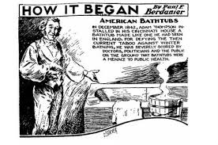
Illustration of Thompson's bathtub, published in the Chronicle-Telegram, November 18, 1935 -- nine years after Mencken's confession.
From “Museum of Hoaxes” – Alex Boese

Slide 23
FAKE NEWS!!! THE WORST THING H.L. MENCKEN EVER DID IN HIS ENTIRE JOURNALISTIC CAREER (AND ABOUT AN INVENTION!)

Slide 24
LIONS AND TIGERS AND BEARS, OH MY; FAKE NEWS IS BAD AND MUST SAY BYE.
WE GET SECRET HELP FROM A HIGH RANKING OFFICIAL WITH A MINING ENGINEERING BACKGROUND FROM STANFORD AND KNOWLEDGE OF OUR COUSINS IN YAKUTSK, SIBERIA. IN THE 20th CENTURY HE WORKED WITH EXECUTIVES OF THE RUSSIAN MINES LOCATED IN THE ALTAI MOUNTAINS OF SIBERIA, WHICH INCLUDED RICH DEPOSITS OF OXIDIZED LEAD-ZINC-SILVER ORE CONTAINED IN COPPER AND GOLD.
HE HAS ACCESS TO ADVANCED COMMUNICATIONS EQUIPMENT, AND TRANSMITS A S.O.S. FOR US ON ENCRYPTED 4525 AND 7010 KhZ SIGNALS, ADJACENT THE REAL AND FAKE “BUZZER.” IT IS LIKE STEALING FROM THE JEWELRY SHOP ADJACENT THE POLICE STATION. WHO WOULD GUESS?
CALLING YAKUTSK - CALLING YAKUTSK – DO YOU READ ME?
WE IN THE U.S. NEED DELIVERANCE FROM FAKE NEWS. THOSE IN MOSCOW AND ST. PETERSBURG DO NOT HAVE A PROBLEM WITH FAKE NEWS. WE NEED TO CLEAN OUR COUNTRY LIKE A GOOD HOOVER VACUUM AND GET RID OF ALL FAKE NEWS.
SEND HELP!

Slide 25
OH AMERICAN COUSIN. THIS IS YAKUTSK. WE READ YOU LOUD AND CLEAR!
WE HAVE CONVENED OUR HACKERS ER AH SPIRITUAL LEADERS IN OUR SACRED SNOWBANKS NORTH OF YAKUTSK AND SAY A LITTLE PRAYER FOR YOU.
YOU DO NOT NEED HELP FROM THAT EUROMESS “PUT IN” ST. PETERSBURG AND MOSCOW. THEY LIKE TO VACATION IN SIBERIA TO FEEL LIKE BIG MEN. IT IS OKAY. THEY SPEND BIG MONEY ON BIG VACATIONS.
WE HAVE PRAYED AND THE ALMIGHTY IS SENDING YOU A DELIVERER FROM FAKE NEWS!
PLEASE ACCEPT YOUR DELIVERER WE ARE SENDING YOU. HE MEANS WELL.
WE LOVE YOU SINCE YOU HELPED US WIN THE BIG ONE – WWII.
SINCERELY WITH A WARM SIBERIAN HEART,
THE SIBERIANS.

Slide 26
Oh Mighty and Distant Siberian Cousins,
Who Helped The United States Win The Big One!
Thank You For Praying In Your Snow Banks Near
The Frozen Steppes Of Yakutsk And Invoking The
Aid Of The Almighty And Sending This Holy One To
Deliver Us From Evil -
That Evil Known As -
FAKE NEWS!
PERHAPS TRUMP IS RIGHT ABOUT FAKE NEWS – MENCKEN WOULD AGREE WITH HIM – WHOEVER DREAMED A JOKE ABOUT AN INVENTION OF THE BATHTUB, STARTED BY MENCKEN, WOULD STILL BE GOING STRONG ALMOST 100 YEARS LATER. THIS SHOWS THE POWER IN THE EARLY 20TH CENTURY MIND OF INVENTORS AND INVENTIONS AND TECHNOLOGICAL DEVELOPMENT.

Slide 27
TWO MATTERS TO NOTE: 1) WE FOUND THE CULPRIT; AND 2) THE GREAT IMPORTANCE PLACED ON INVENTORS AND INVENTIONS
REMEMBER TV’S ROWAN & MARTIN’S “LAUGH-IN”AND GERMAN GUY WITH HIS “VEDY INTERVESTING!”
VE HAVE LOOKED HARD AND VE HAVE FOUND ZE GUILTY PARTY MESSIN WITH OUR PRESIDENTIAL ELECTION.
HE HAS MANY RUSSIAN CONNECTIONS. HE MADE MUCH MONEY FROM ZE RUSSIANS.
VE ARE LOOKING FOR HIM NOW. SOME LEADS SAY HE IS HIDING IN A BOX SIX FEET UNDER ZE EARTH.
VE DO NOT BELIEVE THEM. VE BELIEVE HE HAS LEFT ZE COUNTRY AND IS HIDING IN CHINA, WHERE HE USED TO VORK AND WHERE BOTH HE AND HIS VIFE LEARNED TO SPEAK MANDARIN.
VE HAVE LOCATED HIM USING EXTENSIVE DATABASE MINING. ZE GUILTY PARTY GOES BY ZE CODE NAME “HERBERT C. HOOVER,” FORMER REPUBLICAN PRESIDENT OF ZE UNITED STATES.
CASE CLOSED AND YOU HAVE YOUR MAN.
INVENTORS AND INVENTIONS WERE IMPORTANT. TOM SWIFT SAVES THE ALLIES WITH A NEW TANK HE INVENTS AND PERHAPS THE GREATEST JOURNALIST IN THE FIRST HALF OF THE 20TH CENTURY, H.L. MENCKEN, USES FAKE NEWS ABOUT AN INVENTION AND DEVELOPMENT OF THE BATHTUB FOR LIGHT HEARTED FUN TO RELIEVE WAR STRESS. HE NEVER DREAMED IT WOULD GET OUT OF CONTROL AND COULD NOT BE STOPPED.
JUSTICE DOUGLAS: PERHAPS TRYING TO PROTECT THIS IMPORTANCE OF INVENTORS, INVENTIONS, AND PATENTS IN 1941 WITH HIS DECISION IN CUNO AND THE “FLASH OF GENIUS.”

Slide 28
Father died early in his life and raised poor.
Smart kid and well rid. Very Practical. Received college scholarship to Whitman College. Temporarily slept in a tent because he was poor.
Attended Columbia Law School, worked at Cravath, taught at Yale, ran SEC, and appointed one of youngest Supreme Court justices.
Holds the record for most opinions, often writing them in about 20 minutes and publishing first draft.
Hiked entire Appalachian Trail – 2000 miles.
Practical and knew his gadgets.
Issued the finest dissent in the history of the Supreme Court in Sierra Club v. Morton – inanimate objects, i.e., rocks, have standing. Very important since a new Star Wars movie is coming soon – May The Force Be With You.
In 1954 Supreme Court Justice William O. Douglas led journalists on a 185-mile hike along Maryland’s historic C&O Canal to protest plans to turn the adjoining path into a highway. The canal and path became a national park in 1971. National Park Service/Flickr, CC BY.

Slide 29
Cuno Engineering Corp. v. Automatic Devices Corp., 314 U.S. 84 (1941)
Patent No. 1,736,544 for Cigar Lighter
Used in automobiles. Patent assigned to a patent holding company.
Mead's addition to the so-called wireless or cordless lighter of a thermostatic control -- which, after the plug was set "on" and the heating coil had reached the proper temperature, automatically returned the plug to its "off" position -- was not invention, but a mere exercise of the skill of the calling, and an advance plainly indicated by the prior art.
That Mead's combination performed a new and useful function did not make it patentable. The new device, however useful, must reveal the flash of creative genius, not merely the skill of the calling.

Slide 30
(Various Quotes With Citations Omitted)
Under the statute …the device must not only be "new and useful," it must also be an "invention" or "discovery." It has been recognized that, if an improvement is to obtain the privileged position of a patent, more ingenuity must be involved than the work of a mechanic skilled in the art.
Perfection of workmanship, however much it may increase the convenience, extend the use, or diminish expense, is not patentable."
That is to say, the new device, however useful it may be, must reveal the flash of creative genius, not merely the skill of the calling. If it fails, it has not established its right to a private grant on the public domain.
Tested by that principle, Mead's device was not patentable. We cannot conclude that his skill in making this contribution reached the level of inventive genius which the Constitution, Art. I, § 8, authorizes Congress to reward. He merely incorporated the well known thermostat into the old "wireless" lighter to produce a more efficient, useful, and convenient article.. A new application of an old device may not be patented if the "result claimed as new is the same in character as the original result" even though the new result had not before been contemplated. Certainly the use of a thermostat to break a circuit in a "wireless" cigar lighter is analogous to or the same in character as the use of such a device in electric heaters, toasters, or irons, whatever may be the difference in detail of design. Ingenuity was required to effect the adaptation, but no more than that to be expected of a mechanic skilled in the art.
Strict application of that test is necessary lest, in the constant demand for new appliances, the heavy hand of tribute be laid on each slight technological advance in an art. The consequences of the alternative course were forcefully pointed out by Mr. Justice Bradley in Atlantic Works v. Brady, 107 U. S. 192, 107 U. S. 200:
"Such an indiscriminate creation of exclusive privileges tends rather to obstruct than to stimulate invention. It creates a class of speculative schemers who make it their business to watch the advancing wave of improvement, and gather its foam in the form of patented monopolies, which enable them to lay a heavy tax upon the industry of the country without contributing anything to the real advancement of the art. It embarrasses the honest pursuit of business with fears and apprehensions of concealed liens and unknown liabilities to lawsuits and vexatious accountings for profits made in good faith."

Slide 31
Chief Justice Stone concurs:
The commercially successful structure for which respondent claims the protection of the Mead patent and which the court below thought satisfied a felt need, is not the structure described by Mead. Both embody the combination of a thermostatically controlled heating circuit with a heating unit borne on a removable wireless plug and used as a means to close the circuit. But they differ structurally in a number of particulars.
To mention only the more important, Mead showed a rotatable socket which is turned by manually rotating the plug when placed in the socket, so as to close the heating circuit. A laterally extending pin projecting from the side of the plug in the Mead structure engages with a spring latch outside the socket to hold the plug and socket in the circuit closing position to which they have been rotated until the latch is released by the thermostatic control, thus permitting the plug and the socket, which is activated by a spring, to rotate back to the open circuit position. The base required for the accommodation of the rotating socket and its externally operated mechanism was large and cumbersome. Respondent's commercial structure, like the alleged infringing device, utilizes a fixed socket within which the thermostatic circuit control is located and into which the heat unit carrying plug may be inserted without necessity of rotating it, as in the case of the rotating plug with the projecting pin shown by Mead. The thermostatically controlled circuit is closed by pressing the plug further into the socket, the plug being restored to an open circuit position by a spring carried on the plug, when the latch maintaining the closed circuit is thermostatically released.
The commercially exploited device, because of the differences in its structure from that shown by Mead, is the more compact and easily operated. Its utility as a lighter to be located on the dash of an automobile, which is said to be the merit of the Mead invention, is obvious. If the improvements resulting in such utility involved invention, it is not the invention of Mead. If they exhibited only the skill of the art, their success cannot be relied on to establish invention by Mead, who did not show or make them. The case is therefore not one for the application of the doctrine that commercial success or the manifest satisfaction of a felt need will turn the scale in favor of invention

Slide 32
Graham v. John Deere Co., 383 U.S. 1 (1966)
Quotes With Some Citations Omitted
It also seems apparent that Congress intended by the last sentence of § 103 to abolish the test it believed this Court announced in the controversial phrase "flash of creative genius," used in Cuno Engineering Corp. v. Automatic Devices Corp., 314 U. S. 84 (1941). It is contended, however, by some of the parties and by several of the amici that the first sentence of § 103 was intended to sweep away judicial precedents and to lower the level of patentability. Others contend that the Congress intended to codify the essential purpose reflected in existing judicial precedents -- the rejection of insignificant variations and innovations of a commonplace sort -- and also to focus inquiries under § 103 upon nonobviousness, rather than upon "invention," as a means of achieving more stability and predictability in determining patentability and validity.
The Reviser's Note to this section, with apparent reference to Hotchkiss, recognizes that judicial requirements as to "lack of patentable novelty [have] been followed since at least as early as 1850." The note indicates that the section was inserted because it "may have some stabilizing effect, and also to serve as a basis for the addition at a later time of some criteria which may be worked out." To this same effect are the reports of both Houses, supra, which state that the first sentence of the section "paraphrases language which has often been used in decisions of the courts, and the section is added to the statute for uniformity and definiteness."
We believe that this legislative history, as well as other sources,show that the revision was not intended by Congress to change the general level of patentable invention. We conclude that the section was intended merely as a codification of judicial precedents embracing the Hotchkiss condition, with congressional directions that inquiries into the obviousness of the subject matter sought to be patented are a prerequisite to patentability.

Slide 33
Four Tips For Arguing Secondary Considerations At The PTAB From Law360 and Author Matthew Bultman
Show The Light Bulb Went Off. Justice Douglas and his Flash of Genius?
Connect the Evidence and the Patent. Tough to show the Nexus. Have a Tight Connection Between the Evidence and the Claimed Features.
Make the Claims Match the Evidence. The Evidence must be Specific and Commensurate in Scope to the Subject Matter of the Patent Claims at Issue. Need to Narrow Claims?
You Are Not In District Court. Administrative Patent Judges vs. Juries. Need to be More Specific and Detail-Oriented with Secondary Considerations.

